Slide 1


COURSE SLIDES · NON-WSQ
Canva Design Masterclass
Course code C156
Duration 1 day · 7.5 instructional hours
Provider Tertiary Infotech Academy Pte Ltd · UEN: 201200696W
Version v1.0 · 30 September 2026

Slide 2
GENERAL TRAINER PROFILE
Trainer Profile Template
Name
Industry practice
Adult learning
Trainer: ______________________________
Relevant visual communication, design-production or creative-technology experience.
Approved adult-training credentials for this delivery context.
Facilitation
Quality focus
Contact route
Concept explanation, demonstration, coached practice and evidence review.
Clear hierarchy, visible rationale, verified output and responsible asset use.
Use the provider-approved learner support channel.
Canva Design Masterclass · C156
2

Slide 3
NAMED TRAINER PROFILE
Dr Alfred Ang
Role
Expertise
Facilitation
Principal Trainer · Tertiary Infotech Academy Pte Ltd
Digital transformation, creative technology, courseware development and adult learning.
Concept-first explanation followed by coached practice and evidence review.
Quality focus
Learning culture
Contact
Source alignment, reproducible workflows and clear acceptance criteria.
Ask early and explain the reason behind each design choice.
enquiry@tertiaryinfotech.com · +65 6100 0613
Canva Design Masterclass · C156
3

Slide 4
OPENING DISCUSSION
Your Visual-Communication Context
Role
Channel
Friction
What visual messages do you create or manage?
Screen, social, presentation, workplace or print?
Which Canva or design task currently costs the most time?
Quality
Experience
Evidence
Which communication defect is most visible in current output?
Which Canva feature or design principle is already familiar?
What finished artifact will prove improvement?
Canva Design Masterclass · C156
4

Slide 5
GROUND RULES
Working Agreements
Participate
Respect
Protect assets
Try the tools and explain choices.
Critique the work, not the person.
Use permitted sources and retain rights evidence.
Save versions
Share safely
Verify
Preserve baselines and name pages, versions and exports.
Protect learner work and course content.
Reopen exports before delivery.
Canva Design Masterclass · C156
5

Slide 6
LMS-TMS VISUAL ROUTE
Download Course Materials
1
2
3
4
5
Open LMS-TMS
Select this course
Open Courseware
Download package
Check 10 labs
OUTCOME
Portal: https://lms-tms.tertiaryinfotech.com/ · Confirm the deck, Learner Guide, Lesson Plan and ten image-based lab folders before starting.
Canva Design Masterclass · C156
6

Slide 7
COURSE FLOW
One-Day Learning Journey
1
2
3
4
5
Explore
Compose
Sequence
Evaluate
Enhance
OUTCOME
The morning builds visual language and story flow; the afternoon evaluates, collaborates and delivers a coherent campaign system.
Canva Design Masterclass · C156
7

Slide 8
SIX CONNECTED TOPICS
Course Outline
Topic 1
Topic 2
Topic 3
Introduction to Canva and Basic Design Principles
Interface model · visual brief · hierarchy · typography · layout · media integration
LO1
Colour and Form in Canva Design
Colour relationships · meaning · contrast · shapes · image treatment · context
LO1
Storyboarding and Flow Design in Canva
Narrative beats · sequence · task flow · annotation · transitions · shared intent
LO2
Topic 4
Topic 5
Topic 6
Best Practices and Aesthetic Analysis in Canva
Design principles · usability · rubric-based review · diagnosis · evidence-led recommendations
LO2
Critical Review and Enhancement Strategies
Critique protocol · collaboration · version comparison · prioritisation · iteration
LO3
Innovative Approaches to Design in Canva
Brand systems · reusable templates · collaboration · multi-format adaptation · responsible AI
LO3
Canva Design Masterclass · C156
8

Slide 9
DESIGN ENVIRONMENT
Tools, Materials and Workspace
Hardware
Software
Workspace
Laptop, suitable display, pointing device and reliable storage.
A current supported Canva browser or desktop experience.
Projects, folders, pages, editor panels, layers, position and comments.
Sources
Output brief
Safety
Rights-cleared PNG/JPEG imagery, logos and visual references.
Audience, dimensions, hierarchy, safe area and JPEG quality.
Named baselines, controlled revisions and verified exports.
Canva Design Masterclass · C156
9

Slide 10
TOOL CONTEXT
Canva Scope and Disclaimer
Industry use
Skills course
Interface drift
Campaign graphics, presentations, storyboards, task flows and collaborative review.
This course develops practical visual-communication skills rather than an external Canva certification.
Labels and plan availability may change; design principles remain stable.
Decision over clicks
Responsible AI
Trademark
Choose by message, audience, hierarchy, context and evidence.
Review generated material and retain provenance where relevant.
Canva is a trademark of Canva Pty Ltd; the provider is not affiliated with Canva.
Canva Design Masterclass · C156
10

Slide 11
01
Introduction to Canva and Basic Design Principles
Interface model · visual brief · hierarchy · typography · layout · media integration
LO1
Canva Design Masterclass · C156
11

Slide 12
EDITABLE CONCEPT CHART
Hierarchy Strength by Visual Cue
READ THE CHART
Combine cues deliberately instead of making every element equally prominent.
Editable native PowerPoint chart
Canva Design Masterclass · C156
Conceptual comparison · not measured performance
12

Slide 13
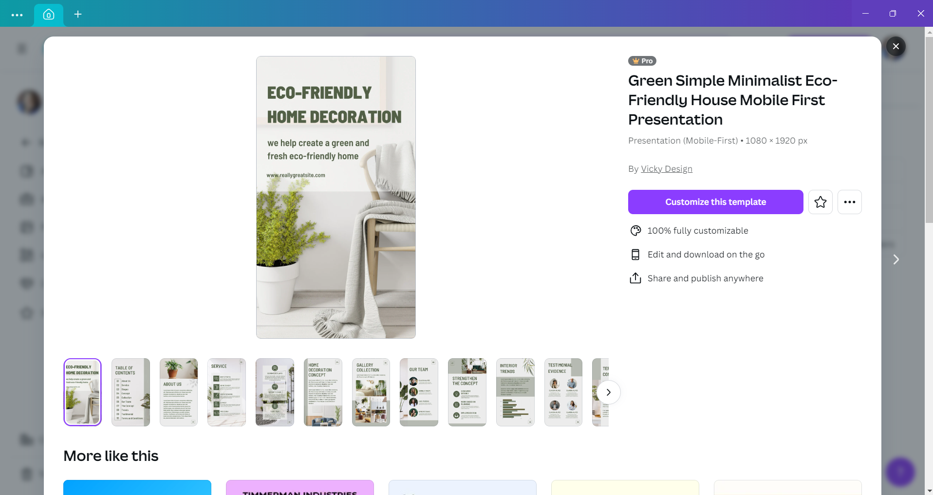
CONCEPT 01 · HOW IT WORKS
Communication Brief
1
How it works
Purpose, audience, message, channel and response define the design problem.
2
Best used for
Preventing template-led design from drifting away from the communication need.
3
Professional decision
Choose this method when its content model and edge behaviour fit the brief.
4
Quality signal
A one-page brief states what the audience must notice, understand and do.
Canva Design Masterclass · C156
Legacy v6 deck · current Canva workflow principles
13

Slide 14
KEY CONTROLS · FAILURE MODE · PROOF
Communication Brief · control and judgement
CONTROL MAP
WATCH FOR
QUALITY PROOF
Audience; single message; call-to-action; format; constraints; success measure.
Starting with a preferred style before the message is clear.
A one-page brief states what the audience must notice, understand and do.
Decision rule · preserve a baseline, isolate the intended change, then inspect at the delivery size.
Canva Design Masterclass · C156
Legacy v6 deck · current Canva workflow principles
14

Slide 15

CONCEPT 02 · HOW IT WORKS
Canva Workspace Model
1
How it works
Projects contain designs; pages contain compositions; the editor brings together templates, elements, text, uploads and apps.
2
Best used for
Navigating Canva without losing track of source assets and versions.
3
Professional decision
Choose this method when its content model and edge behaviour fit the brief.
4
Quality signal
The learner can locate, name, duplicate, share and export the intended design.
Canva Design Masterclass · C156
Legacy v6 deck · current Canva workflow principles
15

Slide 16
KEY CONTROLS · FAILURE MODE · PROOF
Canva Workspace Model · control and judgement
CONTROL MAP
WATCH FOR
QUALITY PROOF
Projects; folders; page names; editor panels; zoom; position; layers; comments.
Interface labels and feature availability may differ by plan and release.
The learner can locate, name, duplicate, share and export the intended design.
Decision rule · preserve a baseline, isolate the intended change, then inspect at the delivery size.
Canva Design Masterclass · C156
Legacy v6 deck · current Canva workflow principles
16

Slide 17
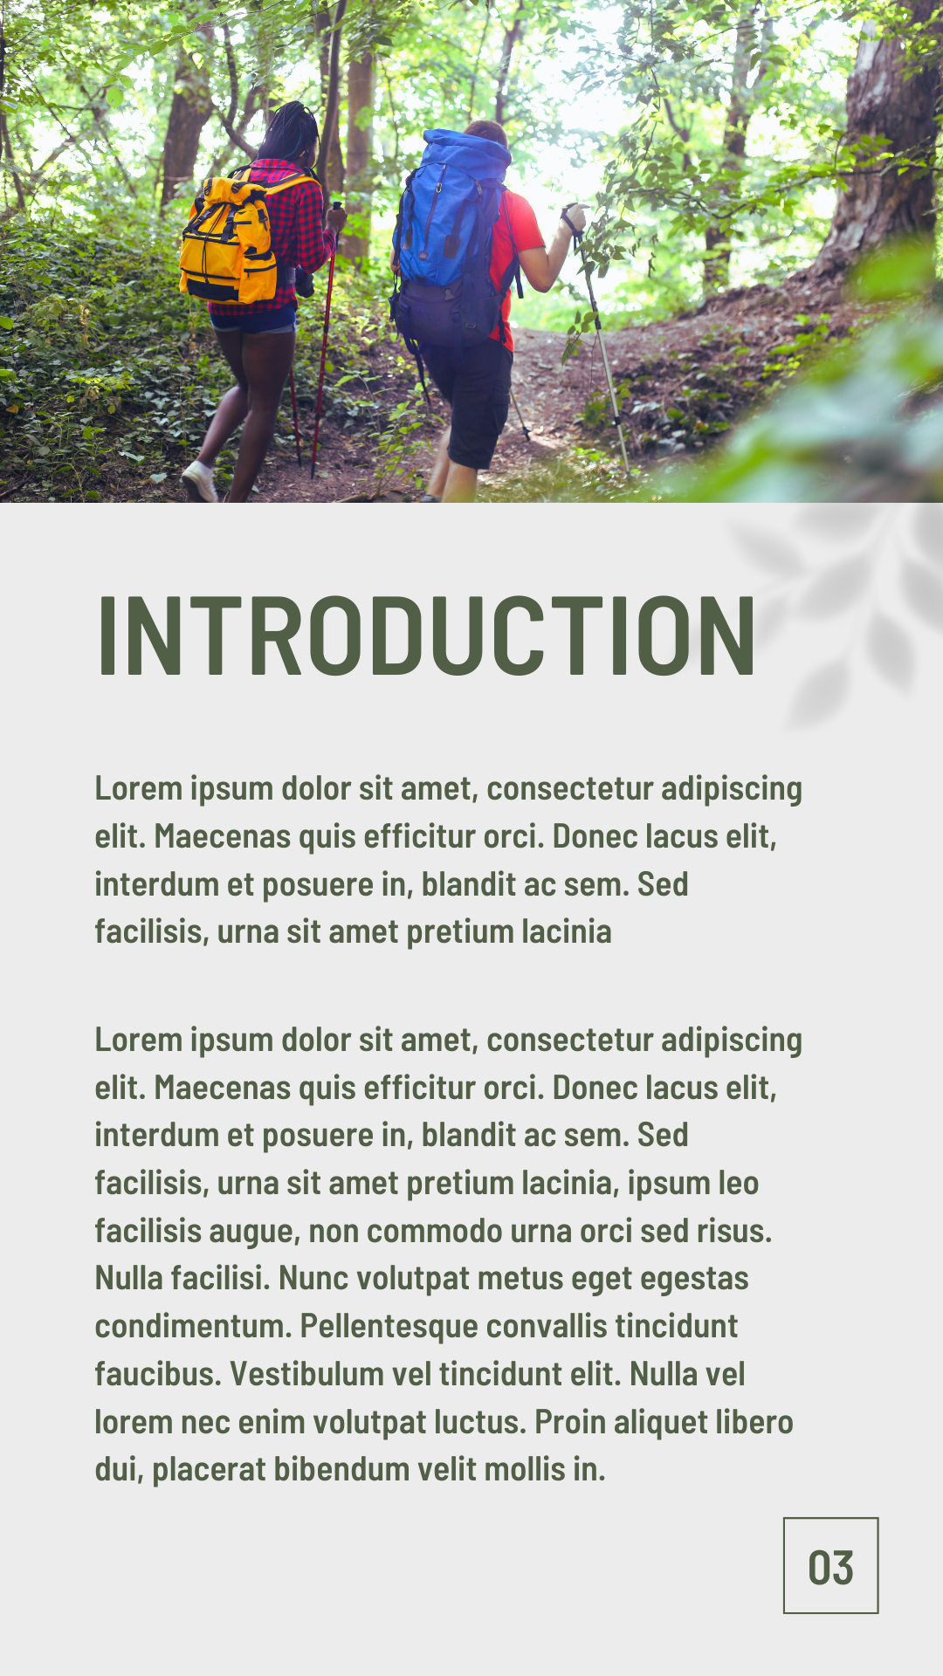
CONCEPT 03 · HOW IT WORKS
Visual Hierarchy
1
How it works
Scale, contrast, position, whitespace and grouping create a reading order.
2
Best used for
Posters, presentations, social graphics and information designs.
3
Professional decision
Choose this method when its content model and edge behaviour fit the brief.
4
Quality signal
A five-second viewing test returns the intended first, second and third messages.
Canva Design Masterclass · C156
Legacy v6 deck · current Canva workflow principles
17

Slide 18
KEY CONTROLS · FAILURE MODE · PROOF
Visual Hierarchy · control and judgement
CONTROL MAP
WATCH FOR
QUALITY PROOF
Primary message; secondary support; body detail; call-to-action; focal point.
Making every element equally large, bright or bold.
A five-second viewing test returns the intended first, second and third messages.
Decision rule · preserve a baseline, isolate the intended change, then inspect at the delivery size.
Canva Design Masterclass · C156
Legacy v6 deck · current Canva workflow principles
18

Slide 19
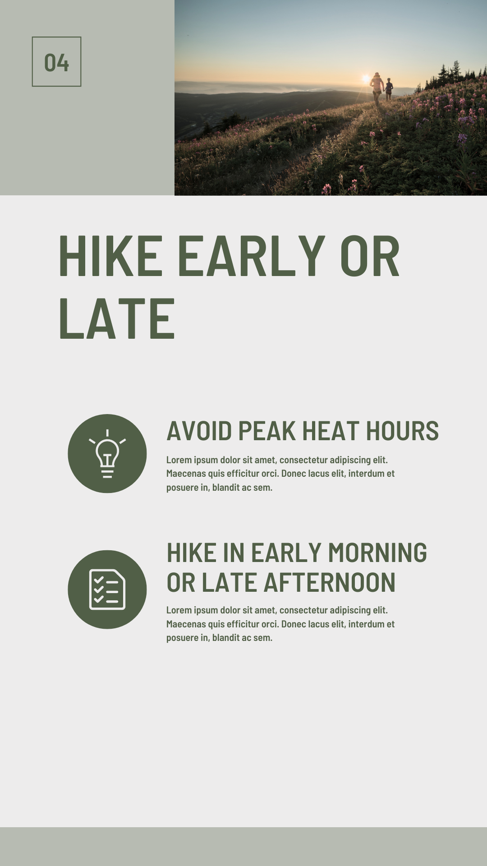
CONCEPT 04 · HOW IT WORKS
Typography System
1
How it works
Display, heading and body roles create consistent hierarchy through type choice and spacing.
2
Best used for
Professional layouts that must remain readable and on-brand.
3
Professional decision
Choose this method when its content model and edge behaviour fit the brief.
4
Quality signal
Text remains legible at delivery size and every type style has a defined role.
Canva Design Masterclass · C156
Legacy v6 deck · current Canva workflow principles
19

Slide 20
KEY CONTROLS · FAILURE MODE · PROOF
Typography System · control and judgement
CONTROL MAP
WATCH FOR
QUALITY PROOF
Typeface role; size; weight; leading; tracking; line length; alignment.
Too many fonts, poor contrast, decorative body type and unlicensed faces.
Text remains legible at delivery size and every type style has a defined role.
Decision rule · preserve a baseline, isolate the intended change, then inspect at the delivery size.
Canva Design Masterclass · C156
Legacy v6 deck · current Canva workflow principles
20

Slide 21
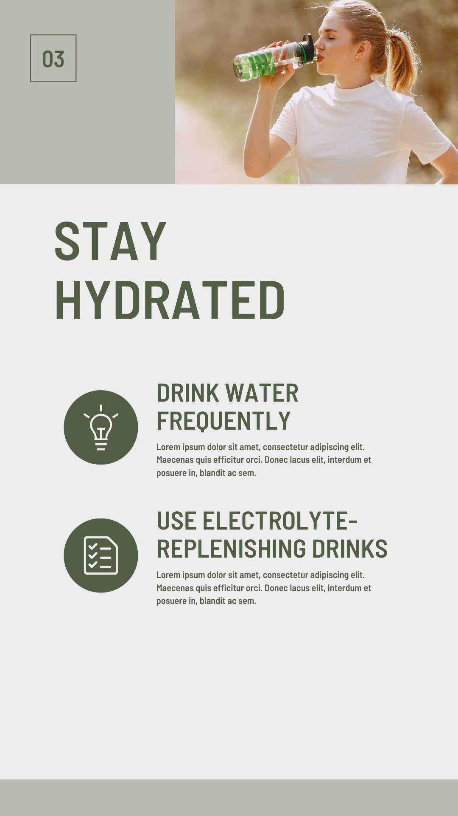
CONCEPT 05 · HOW IT WORKS
Grid, Alignment and Negative Space
1
How it works
Invisible columns and shared edges create order while negative space separates and emphasises.
2
Best used for
Layouts with multiple images, text blocks and calls-to-action.
3
Professional decision
Choose this method when its content model and edge behaviour fit the brief.
4
Quality signal
Key elements share a visible alignment logic and the focal content has space.
Canva Design Masterclass · C156
Legacy v6 deck · current Canva workflow principles
21

Slide 22
KEY CONTROLS · FAILURE MODE · PROOF
Grid, Alignment and Negative Space · control and judgement
CONTROL MAP
WATCH FOR
QUALITY PROOF
Margins; columns; gutters; baselines; proximity; balance; breathing room.
Filling every gap or aligning each item to a different edge.
Key elements share a visible alignment logic and the focal content has space.
Decision rule · preserve a baseline, isolate the intended change, then inspect at the delivery size.
Canva Design Masterclass · C156
Legacy v6 deck · current Canva workflow principles
22

Slide 23
HANDS-ON APPLICATION · TOPIC 1
Lab 01 · Visual Brief and Layout Exploration
Translate a communication need into a visual brief and two layout directions.
1
2
3
4
5
Brief
Compose
Compare
Review
Evidence
EVIDENCE
Brief, two layout variants, five-second test note and final JPEG.
Create a workplace heat-exhaustion awareness visual that can be understood quickly by staff.
Full procedure · Learner Guide / Lab 01
Canva Design Masterclass · C156
23

Slide 24
HANDS-ON APPLICATION · TOPIC 1
Lab 02 · Typography Hierarchy and Message Control
Create a readable three-level type system and apply it to an awareness visual.
1
2
3
4
5
Brief
Compose
Compare
Review
Evidence
EVIDENCE
Final JPEG plus a type-style reference showing font roles and settings.
Refine the heat-exhaustion communication so headline, symptoms and action read in the correct order.
Full procedure · Learner Guide / Lab 02
Canva Design Masterclass · C156
24

Slide 25
EXPLAIN THE DESIGN DECISION
Topic 1 Checkpoint
Purpose
Method
Control
What must the audience notice or understand?
Why does this visual method fit the brief?
Which setting most changes the result?
Failure
Proof
Next
What defect would make it unacceptable?
Which view, comparison and export demonstrate quality?
What controlled variation would improve it?
Canva Design Masterclass · C156
25

Slide 26
02
Colour and Form in Canva Design
Colour relationships · meaning · contrast · shapes · image treatment · context
LO1
Canva Design Masterclass · C156
26

Slide 27
EDITABLE DECISION CHART
Contrast Levers
READ THE CHART
Value and scale often remain reliable when colour perception or viewing conditions vary.
Editable native PowerPoint chart
Canva Design Masterclass · C156
Instructional decision scale
27

Slide 28
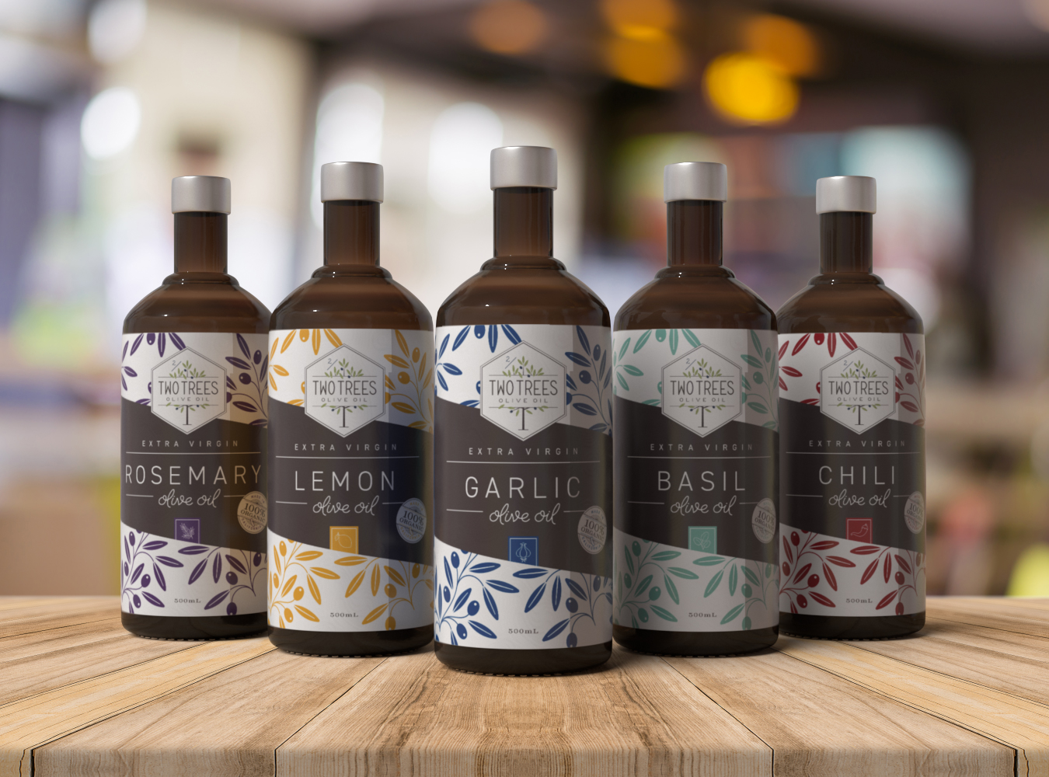
CONCEPT 06 · HOW IT WORKS
Colour Wheel Relationships
1
How it works
Hue relationships organise harmony and contrast through analogous, complementary, split-complementary and triadic schemes.
2
Best used for
Choosing a controlled palette for a mood board or campaign.
3
Professional decision
Choose this method when its content model and edge behaviour fit the brief.
4
Quality signal
A 3–5 colour palette assigns a purpose to every swatch.
Canva Design Masterclass · C156
Legacy v6 deck · current Canva workflow principles
28

Slide 29
KEY CONTROLS · FAILURE MODE · PROOF
Colour Wheel Relationships · control and judgement
CONTROL MAP
WATCH FOR
QUALITY PROOF
Dominant hue; supporting hues; accent; saturation; value; neutral.
Using equal amounts of every palette colour.
A 3–5 colour palette assigns a purpose to every swatch.
Decision rule · preserve a baseline, isolate the intended change, then inspect at the delivery size.
Canva Design Masterclass · C156
Legacy v6 deck · current Canva workflow principles
29

Slide 30
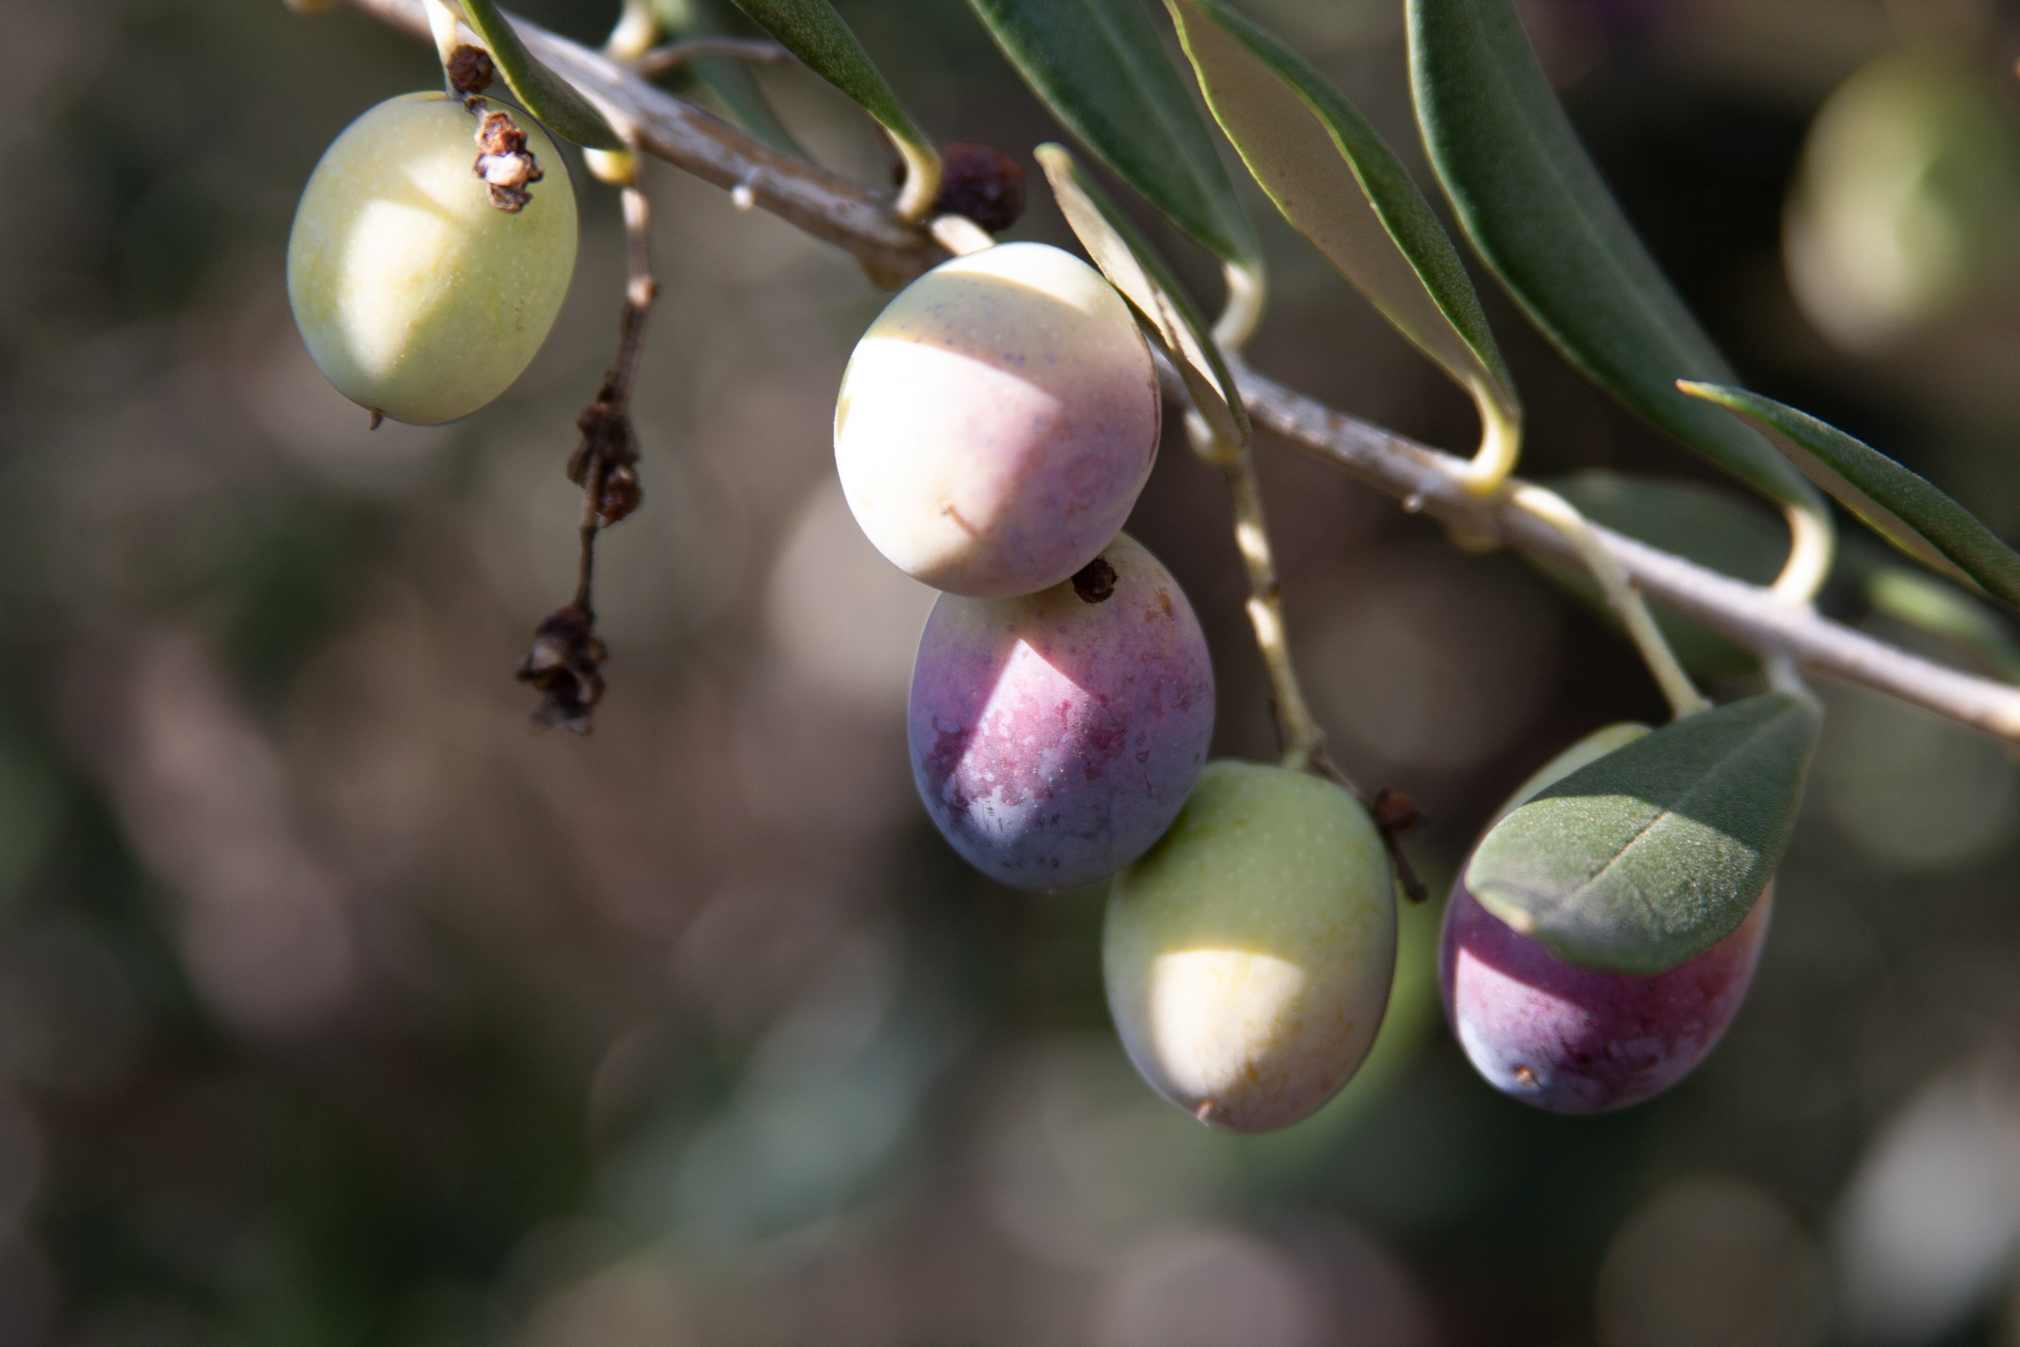
CONCEPT 07 · HOW IT WORKS
Colour Meaning and Context
1
How it works
Colour carries learned associations that change across culture, sector and situation.
2
Best used for
Brand personality, safety communication and emotional framing.
3
Professional decision
Choose this method when its content model and edge behaviour fit the brief.
4
Quality signal
The rationale explains the intended association and how it was checked.
Canva Design Masterclass · C156
Legacy v6 deck · current Canva workflow principles
30

Slide 31
KEY CONTROLS · FAILURE MODE · PROOF
Colour Meaning and Context · control and judgement
CONTROL MAP
WATCH FOR
QUALITY PROOF
Audience; cultural context; sector conventions; emotional objective; testing.
Treating colour psychology as universal or deterministic.
The rationale explains the intended association and how it was checked.
Decision rule · preserve a baseline, isolate the intended change, then inspect at the delivery size.
Canva Design Masterclass · C156
Legacy v6 deck · current Canva workflow principles
31

Slide 32
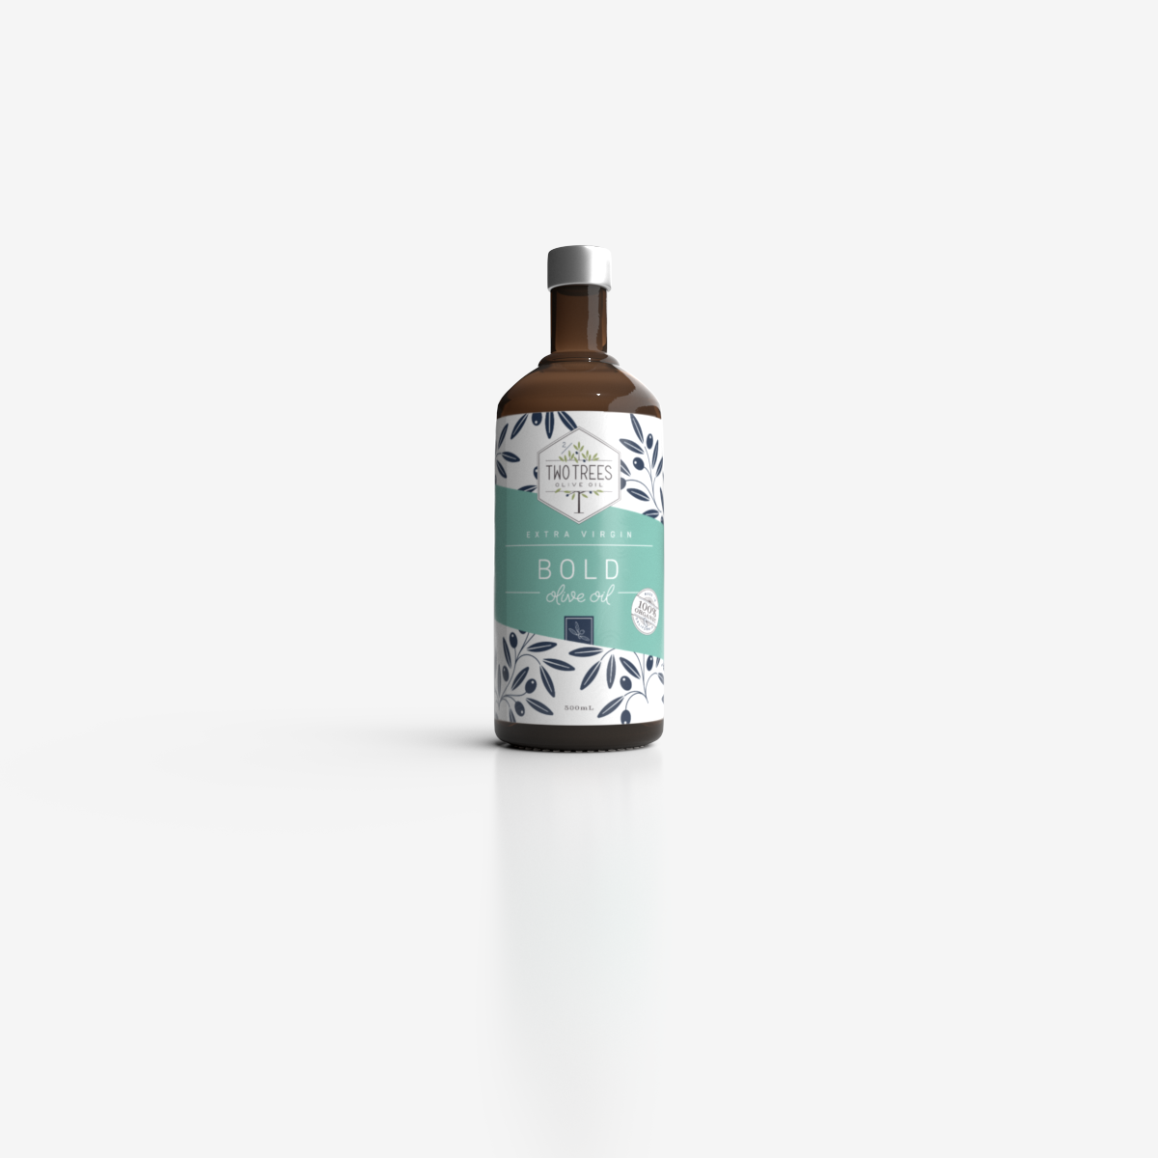
CONCEPT 08 · HOW IT WORKS
Contrast and Accessibility
1
How it works
Value, hue, saturation and size differences separate content and support legibility.
2
Best used for
Text over images, small screens, presentations and public information.
3
Professional decision
Choose this method when its content model and edge behaviour fit the brief.
4
Quality signal
Critical text remains readable in grayscale, at actual size and over the selected image.
Canva Design Masterclass · C156
Legacy v6 deck · current Canva workflow principles
32

Slide 33
KEY CONTROLS · FAILURE MODE · PROOF
Contrast and Accessibility · control and judgement
CONTROL MAP
WATCH FOR
QUALITY PROOF
Foreground/background value; overlay; type size; viewing distance; device.
Relying on colour alone to encode meaning.
Critical text remains readable in grayscale, at actual size and over the selected image.
Decision rule · preserve a baseline, isolate the intended change, then inspect at the delivery size.
Canva Design Masterclass · C156
Legacy v6 deck · current Canva workflow principles
33

Slide 34

CONCEPT 09 · HOW IT WORKS
Shape Language
1
How it works
Geometric and organic forms suggest different qualities and create containers, paths and visual rhythm.
2
Best used for
Brand graphics, diagrams, labels and editorial accents.
3
Professional decision
Choose this method when its content model and edge behaviour fit the brief.
4
Quality signal
Every dominant shape supports message, grouping or movement.
Canva Design Masterclass · C156
Legacy v6 deck · current Canva workflow principles
34

Slide 35
KEY CONTROLS · FAILURE MODE · PROOF
Shape Language · control and judgement
CONTROL MAP
WATCH FOR
QUALITY PROOF
Corners; curvature; repetition; overlap; outline; scale; direction.
Decorative shapes that obscure rather than organise information.
Every dominant shape supports message, grouping or movement.
Decision rule · preserve a baseline, isolate the intended change, then inspect at the delivery size.
Canva Design Masterclass · C156
Legacy v6 deck · current Canva workflow principles
35

Slide 36
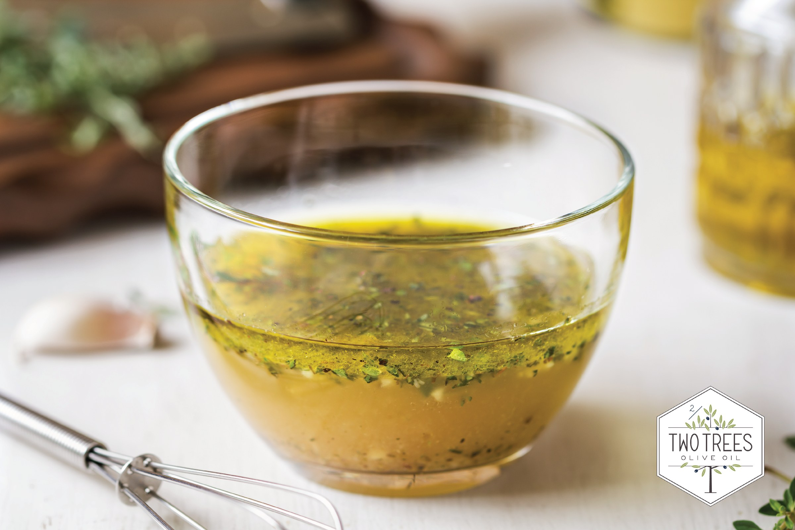
CONCEPT 10 · HOW IT WORKS
Image Integration
1
How it works
Cropping, framing, scale, overlays and colour treatment make photography behave as part of the system.
2
Best used for
Campaigns mixing product, lifestyle and informational imagery.
3
Professional decision
Choose this method when its content model and edge behaviour fit the brief.
4
Quality signal
Images retain correct proportion and share a deliberate visual treatment.
Canva Design Masterclass · C156
Legacy v6 deck · current Canva workflow principles
36

Slide 37
KEY CONTROLS · FAILURE MODE · PROOF
Image Integration · control and judgement
CONTROL MAP
WATCH FOR
QUALITY PROOF
Focal crop; horizon; subject placement; overlay; filter strength; resolution.
Stretching images, cutting key subjects or applying inconsistent filters.
Images retain correct proportion and share a deliberate visual treatment.
Decision rule · preserve a baseline, isolate the intended change, then inspect at the delivery size.
Canva Design Masterclass · C156
Legacy v6 deck · current Canva workflow principles
37

Slide 38
HANDS-ON APPLICATION · TOPIC 2
Lab 03 · Colour and Form Mood Board
Build a controlled mood board that communicates a brand personality through colour, shape and image treatment.
1
2
3
4
5
Brief
Compose
Compare
Review
Evidence
EVIDENCE
One annotated mood-board JPEG and the five-colour palette.
Develop a natural, premium direction for the Two Trees olive-oil range.
Full procedure · Learner Guide / Lab 03
Canva Design Masterclass · C156
38

Slide 39
HANDS-ON APPLICATION · TOPIC 2
Lab 04 · Product Advertisement Design
Integrate product imagery, forms, typography and colour into a persuasive advertisement.
1
2
3
4
5
Brief
Compose
Compare
Review
Evidence
EVIDENCE
Two design variants, comparison note and selected advertisement JPEG.
Create a premium advertisement for one Two Trees olive-oil variety.
Full procedure · Learner Guide / Lab 04
Canva Design Masterclass · C156
39

Slide 40
EXPLAIN THE DESIGN DECISION
Topic 2 Checkpoint
Purpose
Method
Control
What must the audience notice or understand?
Why does this visual method fit the brief?
Which setting most changes the result?
Failure
Proof
Next
What defect would make it unacceptable?
Which view, comparison and export demonstrate quality?
What controlled variation would improve it?
Canva Design Masterclass · C156
40

Slide 41
03
Storyboarding and Flow Design in Canva
Narrative beats · sequence · task flow · annotation · transitions · shared intent
LO2
Canva Design Masterclass · C156
41

Slide 42
EDITABLE SEQUENCE CHART
Storyboard Attention Across Six Frames
READ THE CHART
A planned sequence changes intensity while keeping the final action unmistakable.
Editable native PowerPoint chart
Canva Design Masterclass · C156
Illustrative narrative profile
42

Slide 43
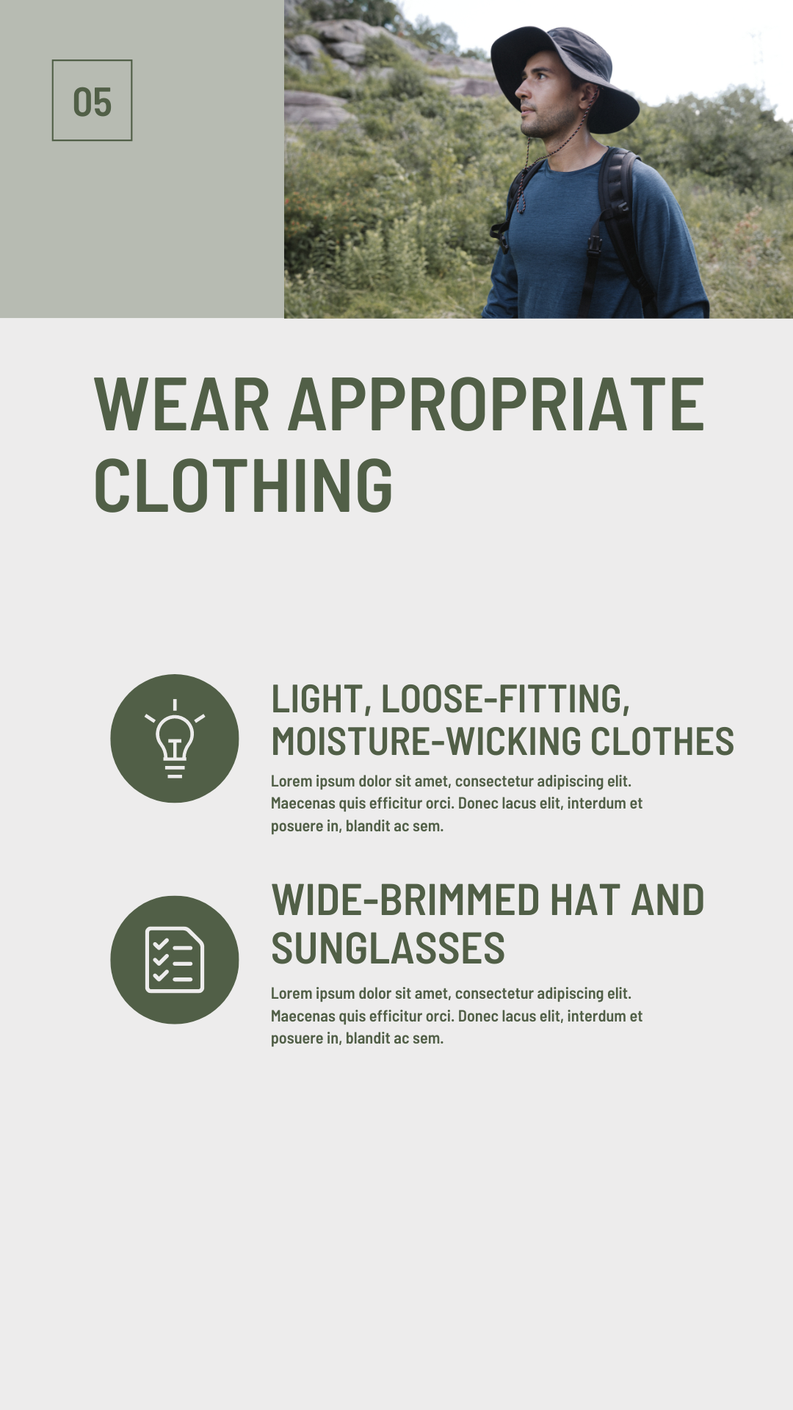
CONCEPT 11 · HOW IT WORKS
Storyboard Structure
1
How it works
Frames represent planned moments and make narrative sequence reviewable.
2
Best used for
Video, animation, presentation and social-story planning.
3
Professional decision
Choose this method when its content model and edge behaviour fit the brief.
4
Quality signal
Each frame advances the message and identifies its production requirement.
Canva Design Masterclass · C156
Legacy v6 deck · current Canva workflow principles
43

Slide 44
KEY CONTROLS · FAILURE MODE · PROOF
Storyboard Structure · control and judgement
CONTROL MAP
WATCH FOR
QUALITY PROOF
Frame number; objective; visual; copy; audio; duration; transition.
Treating a storyboard as polished artwork instead of a decision tool.
Each frame advances the message and identifies its production requirement.
Decision rule · preserve a baseline, isolate the intended change, then inspect at the delivery size.
Canva Design Masterclass · C156
Legacy v6 deck · current Canva workflow principles
44

Slide 45
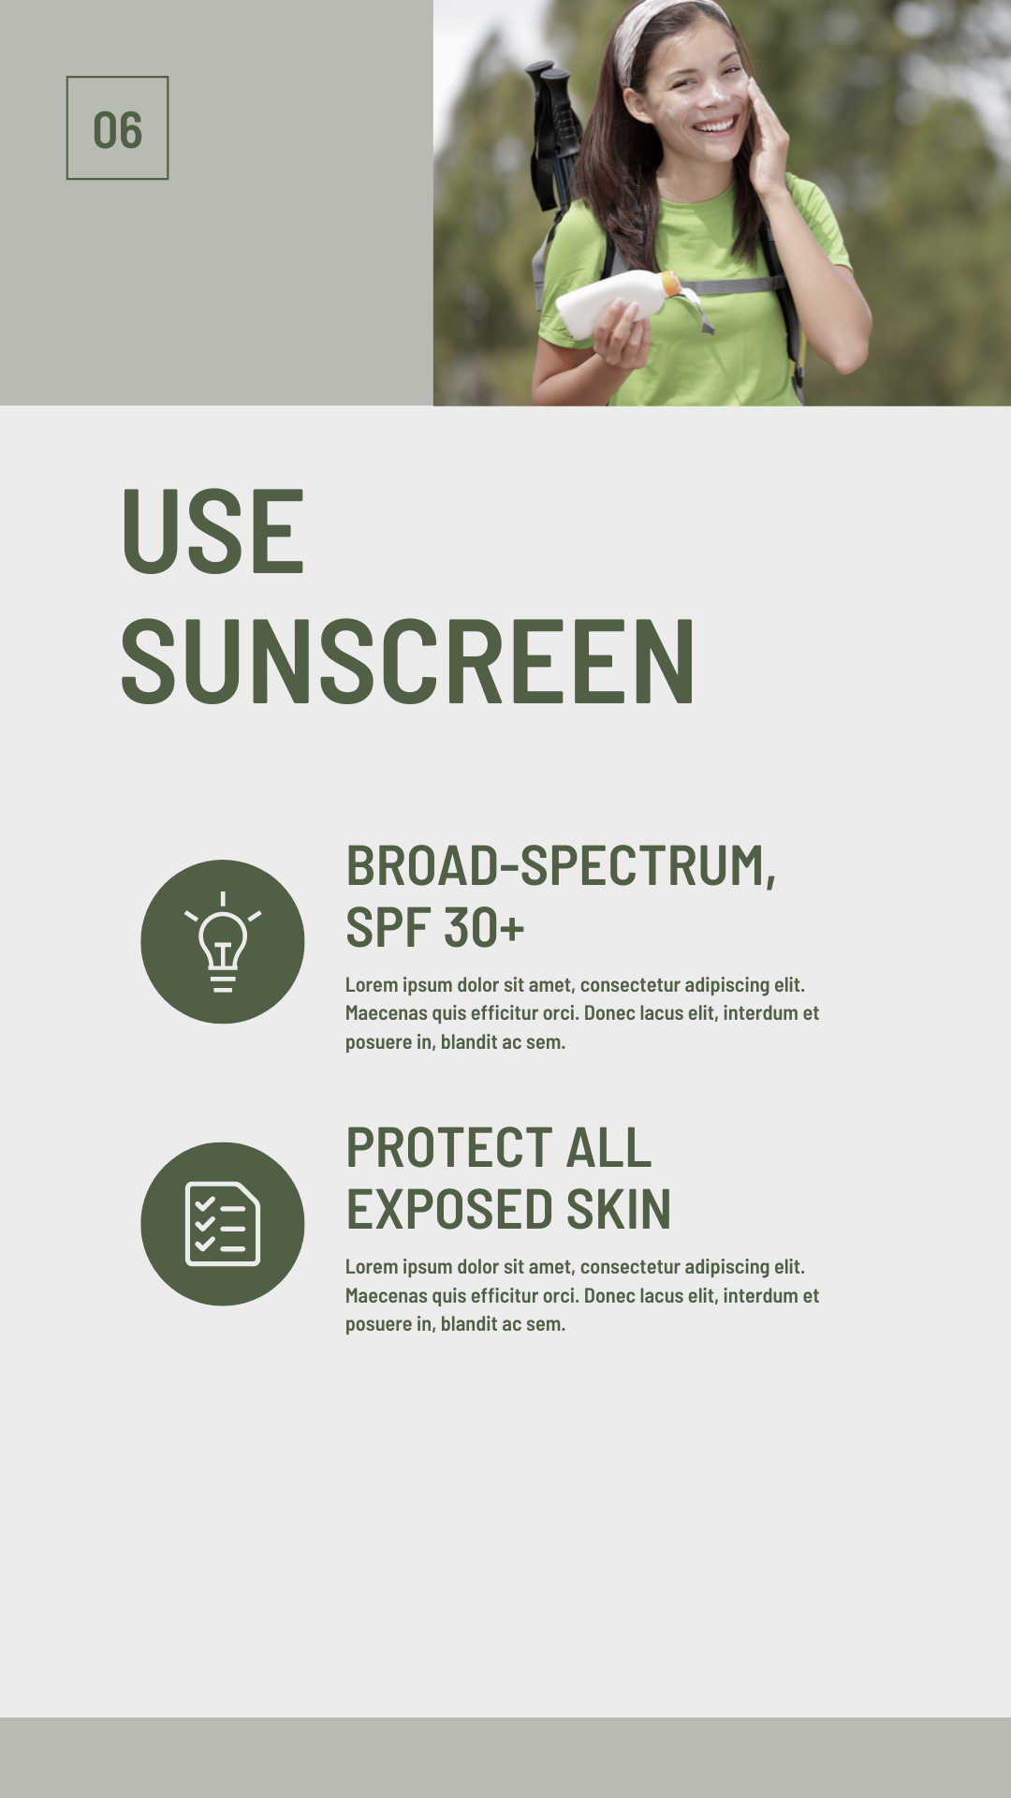
CONCEPT 12 · HOW IT WORKS
Narrative Arc
1
How it works
A beginning establishes context, a middle develops tension or evidence, and an end resolves with a response.
2
Best used for
Short promotional and educational sequences.
3
Professional decision
Choose this method when its content model and edge behaviour fit the brief.
4
Quality signal
A reviewer can summarise the sequence in one sentence.
Canva Design Masterclass · C156
Legacy v6 deck · current Canva workflow principles
45

Slide 46
KEY CONTROLS · FAILURE MODE · PROOF
Narrative Arc · control and judgement
CONTROL MAP
WATCH FOR
QUALITY PROOF
Hook; problem; proof; benefit; resolution; call-to-action.
Too much setup and no clear payoff or next action.
A reviewer can summarise the sequence in one sentence.
Decision rule · preserve a baseline, isolate the intended change, then inspect at the delivery size.
Canva Design Masterclass · C156
Legacy v6 deck · current Canva workflow principles
46

Slide 47
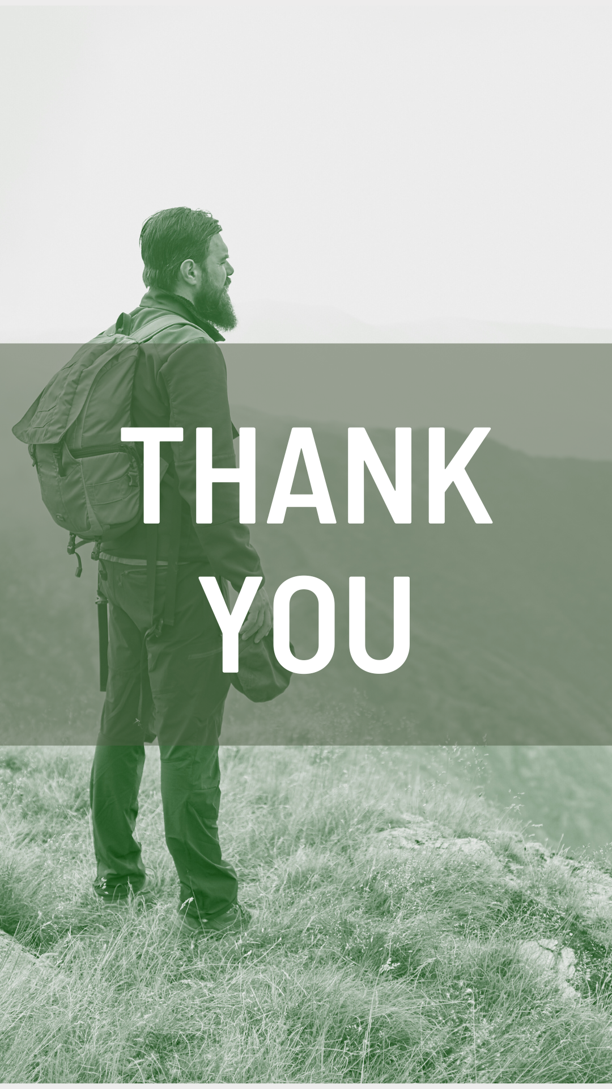
CONCEPT 13 · HOW IT WORKS
Task Flow
1
How it works
Nodes and connectors model actions, decisions, exceptions and completion.
2
Best used for
Service journeys, workflows, instructions and interaction planning.
3
Professional decision
Choose this method when its content model and edge behaviour fit the brief.
4
Quality signal
Every decision has labelled outcomes and every path reaches a valid end.
Canva Design Masterclass · C156
Legacy v6 deck · current Canva workflow principles
47

Slide 48
KEY CONTROLS · FAILURE MODE · PROOF
Task Flow · control and judgement
CONTROL MAP
WATCH FOR
QUALITY PROOF
Start/end; action; decision; branch label; exception; owner.
Crossing connectors, ambiguous branches and missing end states.
Every decision has labelled outcomes and every path reaches a valid end.
Decision rule · preserve a baseline, isolate the intended change, then inspect at the delivery size.
Canva Design Masterclass · C156
Legacy v6 deck · current Canva workflow principles
48

Slide 49
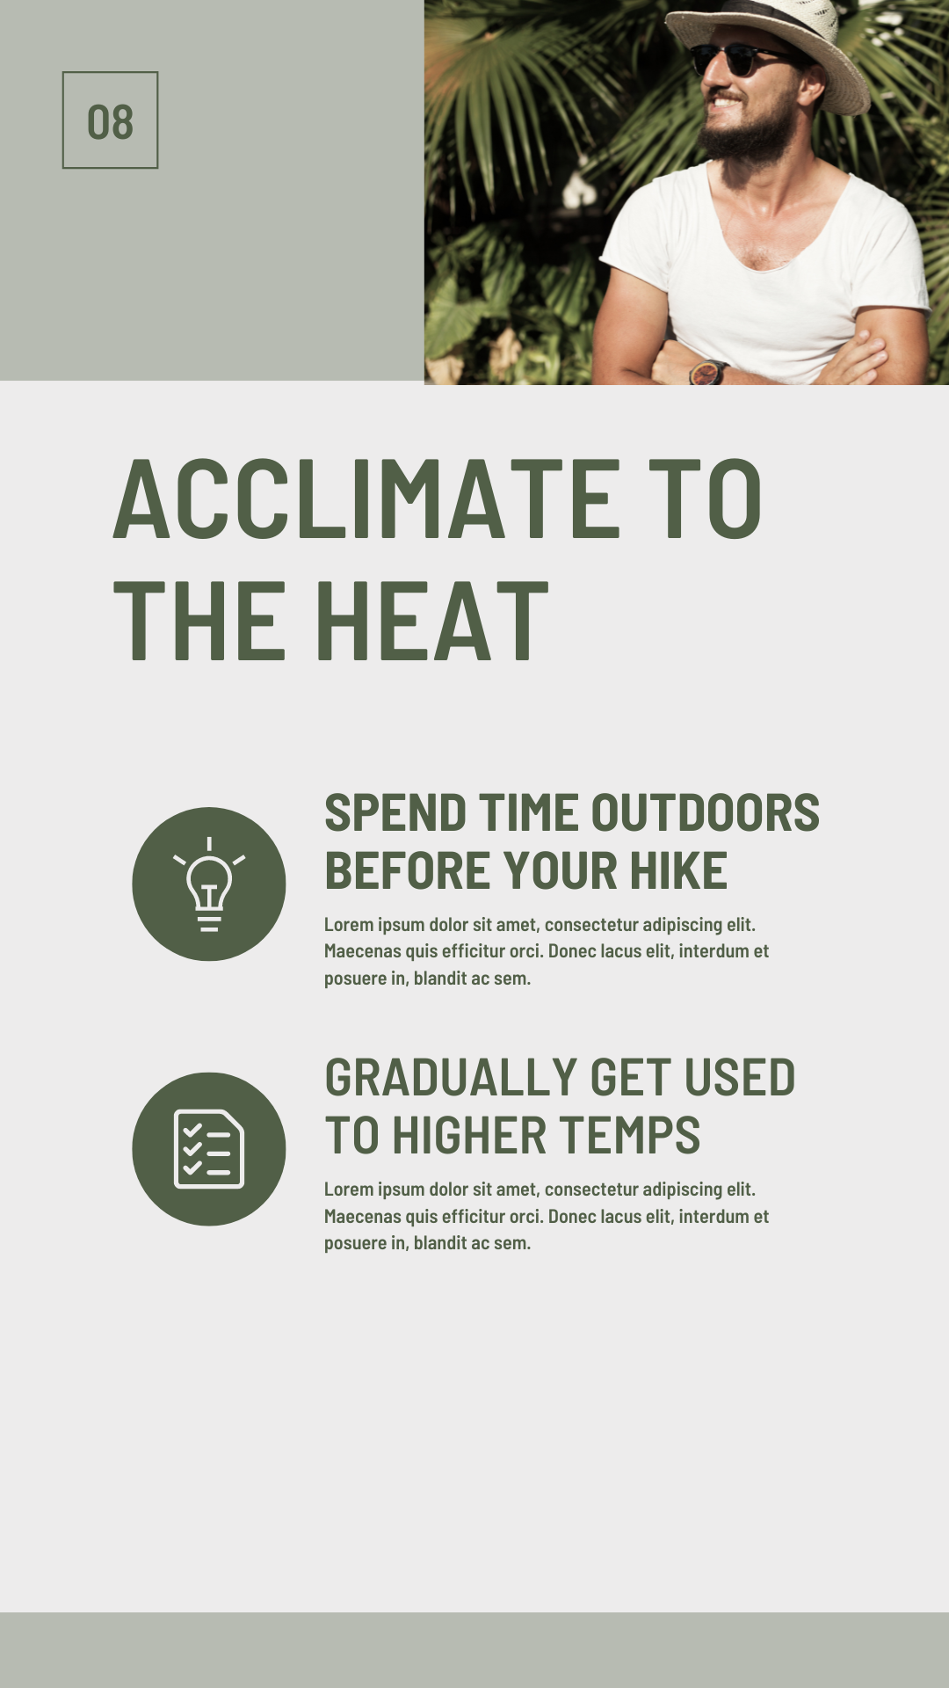
CONCEPT 14 · HOW IT WORKS
Frame Composition and Transition
1
How it works
Shot scale, viewpoint and continuity determine how attention moves between frames.
2
Best used for
Turning a message outline into a coherent visual sequence.
3
Professional decision
Choose this method when its content model and edge behaviour fit the brief.
4
Quality signal
The sequence varies emphasis while preserving continuity.
Canva Design Masterclass · C156
Legacy v6 deck · current Canva workflow principles
49

Slide 50
KEY CONTROLS · FAILURE MODE · PROOF
Frame Composition and Transition · control and judgement
CONTROL MAP
WATCH FOR
QUALITY PROOF
Wide/medium/close; camera angle; screen direction; cut; dissolve; match.
Repeating identical framing or using transitions as decoration.
The sequence varies emphasis while preserving continuity.
Decision rule · preserve a baseline, isolate the intended change, then inspect at the delivery size.
Canva Design Masterclass · C156
Legacy v6 deck · current Canva workflow principles
50

Slide 51
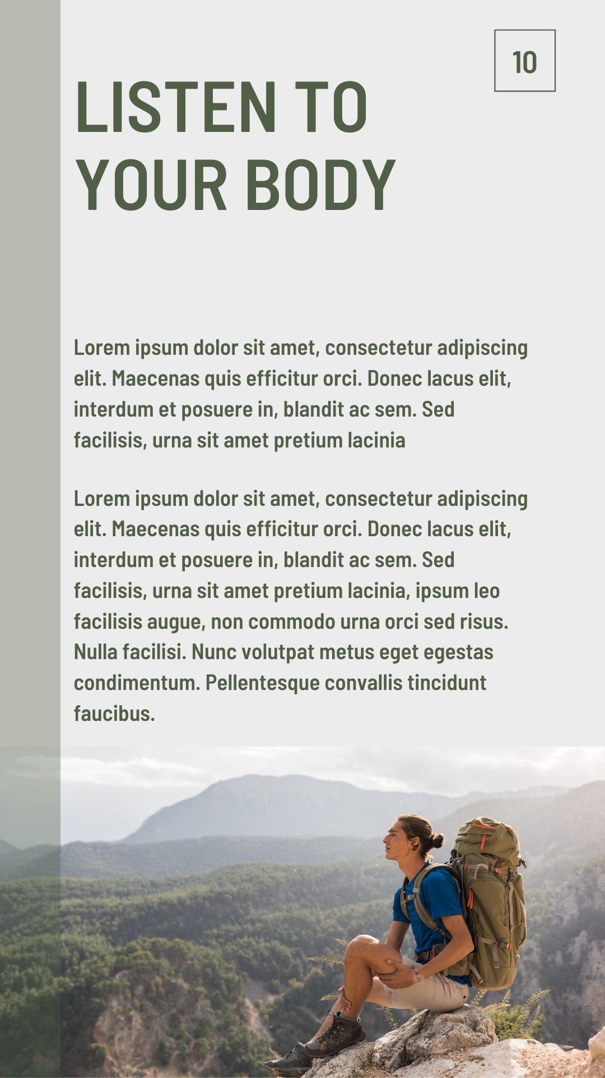
CONCEPT 15 · HOW IT WORKS
Storyboard Handoff
1
How it works
Annotations convert visual intent into shared production instructions.
2
Best used for
Collaborative projects where another person will animate, edit or approve.
3
Professional decision
Choose this method when its content model and edge behaviour fit the brief.
4
Quality signal
Every frame has enough information for the next contributor to act.
Canva Design Masterclass · C156
Legacy v6 deck · current Canva workflow principles
51

Slide 52
KEY CONTROLS · FAILURE MODE · PROOF
Storyboard Handoff · control and judgement
CONTROL MAP
WATCH FOR
QUALITY PROOF
Timing; motion; audio; asset owner; status; comment; acceptance criterion.
Unlabelled placeholders and feedback without ownership.
Every frame has enough information for the next contributor to act.
Decision rule · preserve a baseline, isolate the intended change, then inspect at the delivery size.
Canva Design Masterclass · C156
Legacy v6 deck · current Canva workflow principles
52

Slide 53
HANDS-ON APPLICATION · TOPIC 3
Lab 05 · Storyboard Sequence
Create an annotated storyboard that communicates a short visual narrative to collaborators.
1
2
3
4
5
Brief
Compose
Compare
Review
Evidence
EVIDENCE
Six-frame annotated storyboard JPEG plus sequence-test note.
Plan a six-frame heat-exhaustion awareness video from risk recognition to action.
Full procedure · Learner Guide / Lab 05
Canva Design Masterclass · C156
53

Slide 54
HANDS-ON APPLICATION · TOPIC 3
Lab 06 · Task Flow Design
Model a visual-production workflow with clear actions, decisions and end states.
1
2
3
4
5
Brief
Compose
Compare
Review
Evidence
EVIDENCE
One labelled task-flow JPEG with a verified revision loop.
Map how a marketing team requests, reviews, revises and approves a social graphic.
Full procedure · Learner Guide / Lab 06
Canva Design Masterclass · C156
54

Slide 55
EXPLAIN THE DESIGN DECISION
Topic 3 Checkpoint
Purpose
Method
Control
What must the audience notice or understand?
Why does this visual method fit the brief?
Which setting most changes the result?
Failure
Proof
Next
What defect would make it unacceptable?
Which view, comparison and export demonstrate quality?
What controlled variation would improve it?
Canva Design Masterclass · C156
55

Slide 56
04
Best Practices and Aesthetic Analysis in Canva
Design principles · usability · rubric-based review · diagnosis · evidence-led recommendations
LO2
Canva Design Masterclass · C156
56

Slide 57
EDITABLE QUALITY CHART
Visual Review Weighting
READ THE CHART
Aesthetics alone are insufficient: message, readability and channel fitness carry most review weight.
Editable native PowerPoint chart
Canva Design Masterclass · C156
57

Slide 58

CONCEPT 16 · HOW IT WORKS
Design Principles Rubric
1
How it works
A shared rubric turns visual preference into reviewable criteria.
2
Best used for
Peer review, stakeholder sign-off and self-review.
3
Professional decision
Choose this method when its content model and edge behaviour fit the brief.
4
Quality signal
Ratings cite visible evidence and identify the highest-priority gap.
Canva Design Masterclass · C156
Legacy v6 deck · current Canva workflow principles
58

Slide 59
KEY CONTROLS · FAILURE MODE · PROOF
Design Principles Rubric · control and judgement
CONTROL MAP
WATCH FOR
QUALITY PROOF
Hierarchy; balance; contrast; alignment; proximity; repetition; whitespace.
Scoring without examples or audience context.
Ratings cite visible evidence and identify the highest-priority gap.
Decision rule · preserve a baseline, isolate the intended change, then inspect at the delivery size.
Canva Design Masterclass · C156
Legacy v6 deck · current Canva workflow principles
59

Slide 60
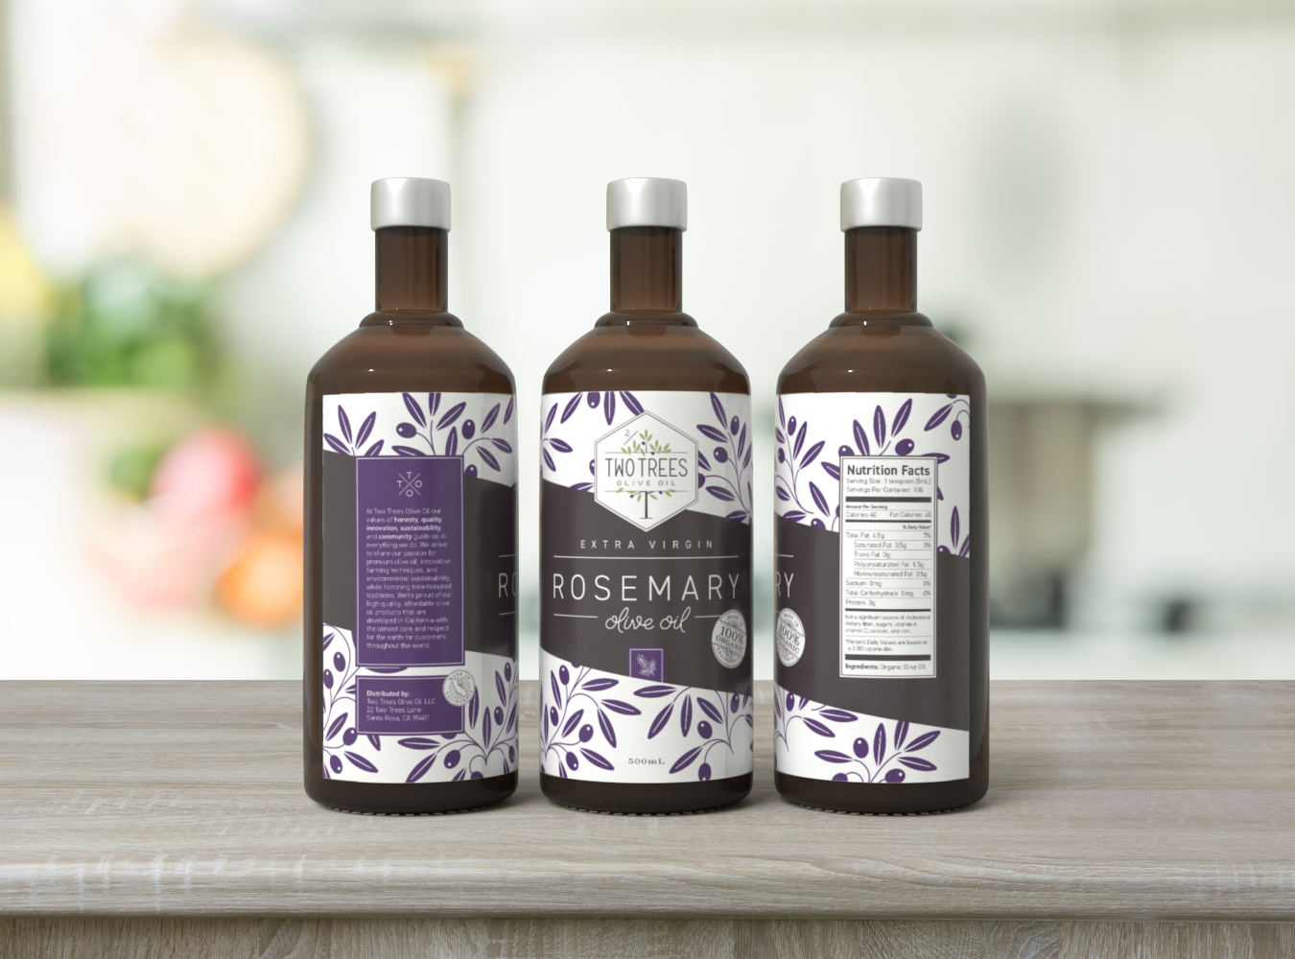
CONCEPT 17 · HOW IT WORKS
Aesthetic and Functional Fit
1
How it works
A design must create the intended tone and still work in its channel.
2
Best used for
Campaigns where visual appeal, clarity and action all matter.
3
Professional decision
Choose this method when its content model and edge behaviour fit the brief.
4
Quality signal
The review separates aesthetic appeal from functional performance.
Canva Design Masterclass · C156
Legacy v6 deck · current Canva workflow principles
60

Slide 61
KEY CONTROLS · FAILURE MODE · PROOF
Aesthetic and Functional Fit · control and judgement
CONTROL MAP
WATCH FOR
QUALITY PROOF
Brand fit; readability; navigation; format; loading; output quality.
Approving a beautiful design that fails the communication task.
The review separates aesthetic appeal from functional performance.
Decision rule · preserve a baseline, isolate the intended change, then inspect at the delivery size.
Canva Design Masterclass · C156
Legacy v6 deck · current Canva workflow principles
61

Slide 62
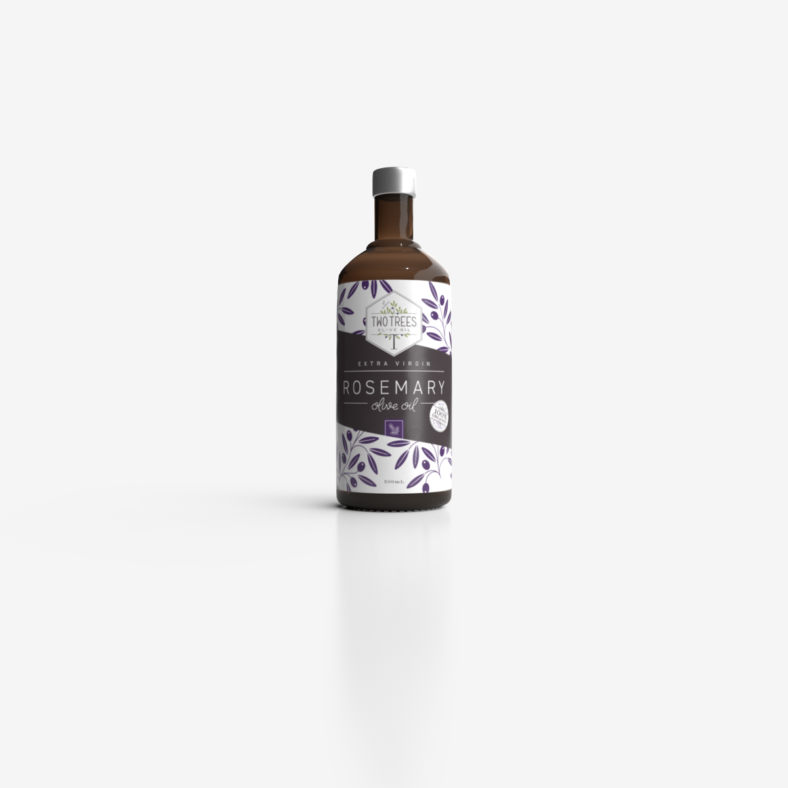
CONCEPT 18 · HOW IT WORKS
Focal Point and Eye Path
1
How it works
Contrast and spatial structure determine where the eye enters and travels.
2
Best used for
Posters, menus, slides and advertisements.
3
Professional decision
Choose this method when its content model and edge behaviour fit the brief.
4
Quality signal
The intended eye path is confirmed by a short observation test.
Canva Design Masterclass · C156
Legacy v6 deck · current Canva workflow principles
62

Slide 63
KEY CONTROLS · FAILURE MODE · PROOF
Focal Point and Eye Path · control and judgement
CONTROL MAP
WATCH FOR
QUALITY PROOF
Largest contrast; face/subject gaze; directional lines; whitespace; grouping.
Multiple competing focal points and a hidden call-to-action.
The intended eye path is confirmed by a short observation test.
Decision rule · preserve a baseline, isolate the intended change, then inspect at the delivery size.
Canva Design Masterclass · C156
Legacy v6 deck · current Canva workflow principles
63

Slide 64
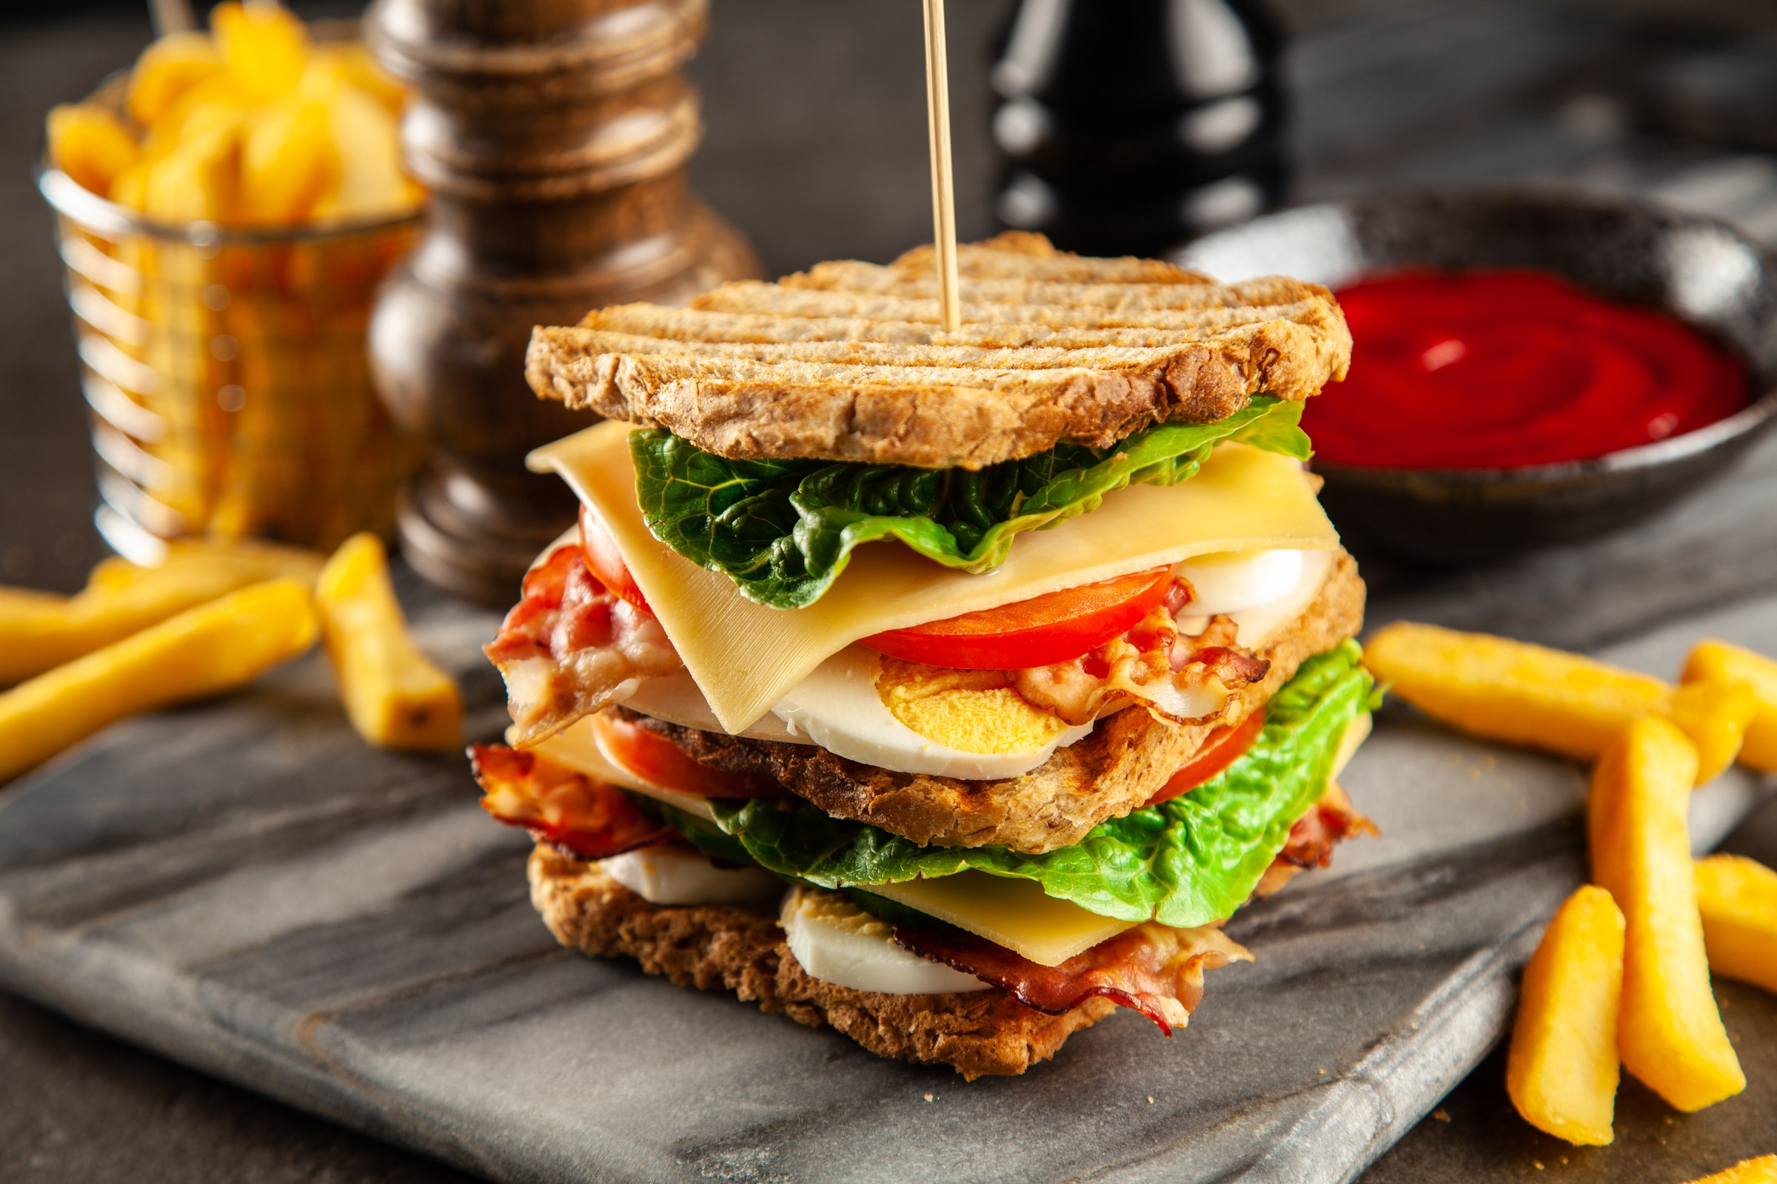
CONCEPT 19 · HOW IT WORKS
Evidence-Led Recommendation
1
How it works
A useful critique links feature, audience effect and specific revision.
2
Best used for
Turning evaluation into actionable design changes.
3
Professional decision
Choose this method when its content model and edge behaviour fit the brief.
4
Quality signal
A collaborator can implement the recommendation without guessing.
Canva Design Masterclass · C156
Legacy v6 deck · current Canva workflow principles
64

Slide 65
KEY CONTROLS · FAILURE MODE · PROOF
Evidence-Led Recommendation · control and judgement
CONTROL MAP
WATCH FOR
QUALITY PROOF
Observation; interpretation; brief criterion; recommended change; expected effect.
Vague comments such as make it pop or I do not like it.
A collaborator can implement the recommendation without guessing.
Decision rule · preserve a baseline, isolate the intended change, then inspect at the delivery size.
Canva Design Masterclass · C156
Legacy v6 deck · current Canva workflow principles
65

Slide 66
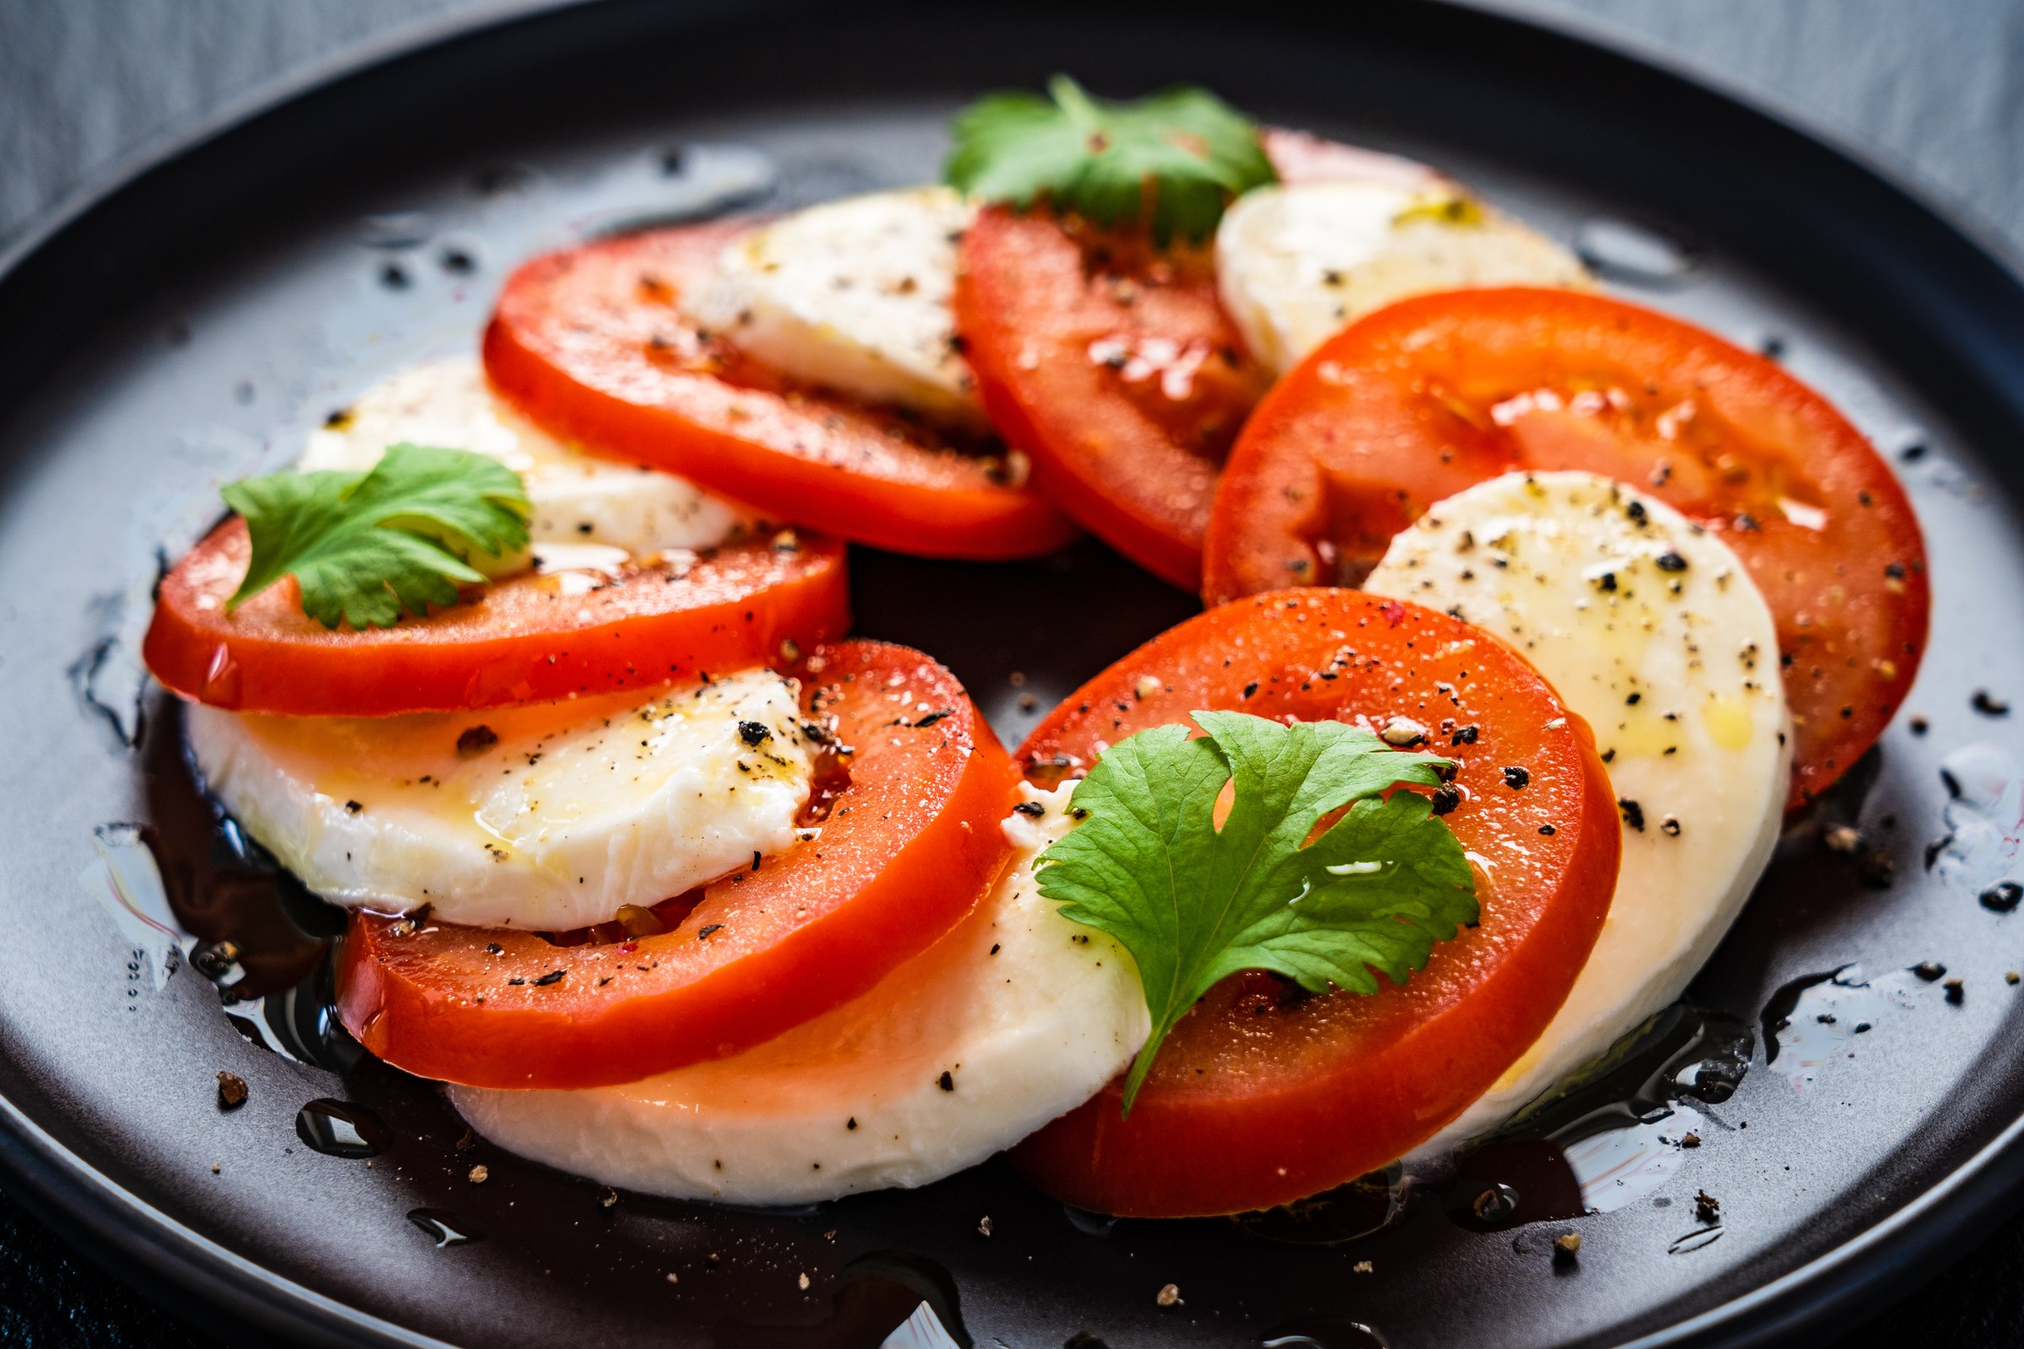
CONCEPT 20 · HOW IT WORKS
Accessibility Review
1
How it works
Inclusive design removes barriers created by weak contrast, small type, dense layouts or colour-only cues.
2
Best used for
Public-facing and workplace communication across devices.
3
Professional decision
Choose this method when its content model and edge behaviour fit the brief.
4
Quality signal
Critical information remains perceivable and understandable in the target context.
Canva Design Masterclass · C156
Legacy v6 deck · current Canva workflow principles
66

Slide 67
KEY CONTROLS · FAILURE MODE · PROOF
Accessibility Review · control and judgement
CONTROL MAP
WATCH FOR
QUALITY PROOF
Contrast; minimum type size; reading order; plain language; alternatives.
Testing only on the designer's large monitor.
Critical information remains perceivable and understandable in the target context.
Decision rule · preserve a baseline, isolate the intended change, then inspect at the delivery size.
Canva Design Masterclass · C156
Legacy v6 deck · current Canva workflow principles
67

Slide 68
HANDS-ON APPLICATION · TOPIC 4
Lab 07 · Aesthetic and Functional Audit
Evaluate a design with a shared rubric and propose specific enhancements.
1
2
3
4
5
Brief
Compose
Compare
Review
Evidence
EVIDENCE
Completed rubric and side-by-side baseline/revised JPEG.
Review the Two Trees product advertisement as if preparing it for stakeholder approval.
Full procedure · Learner Guide / Lab 07
Canva Design Masterclass · C156
68

Slide 69
EXPLAIN THE DESIGN DECISION
Topic 4 Checkpoint
Purpose
Method
Control
What must the audience notice or understand?
Why does this visual method fit the brief?
Which setting most changes the result?
Failure
Proof
Next
What defect would make it unacceptable?
Which view, comparison and export demonstrate quality?
What controlled variation would improve it?
Canva Design Masterclass · C156
69

Slide 70
05
Critical Review and Enhancement Strategies
Critique protocol · collaboration · version comparison · prioritisation · iteration
LO3
Canva Design Masterclass · C156
70

Slide 71
EDITABLE QUALITY CHART
Visual Review Weighting
READ THE CHART
Aesthetics alone are insufficient: message, readability and channel fitness carry most review weight.
Editable native PowerPoint chart
Canva Design Masterclass · C156
71

Slide 72

CONCEPT 21 · HOW IT WORKS
Critique Protocol
1
How it works
Describe, ask, interpret, recommend and decide creates a respectful evidence-led conversation.
2
Best used for
Peer review sessions and stakeholder presentations.
3
Professional decision
Choose this method when its content model and edge behaviour fit the brief.
4
Quality signal
The review record separates observations, decisions and actions.
Canva Design Masterclass · C156
Legacy v6 deck · current Canva workflow principles
72

Slide 73
KEY CONTROLS · FAILURE MODE · PROOF
Critique Protocol · control and judgement
CONTROL MAP
WATCH FOR
QUALITY PROOF
Brief restatement; design rationale; reviewer question; note; decision.
Defending every choice or critiquing personal taste.
The review record separates observations, decisions and actions.
Decision rule · preserve a baseline, isolate the intended change, then inspect at the delivery size.
Canva Design Masterclass · C156
Legacy v6 deck · current Canva workflow principles
73

Slide 74

CONCEPT 22 · HOW IT WORKS
Specific Feedback
1
How it works
Narrow feedback identifies what is working, what is not and why.
2
Best used for
Reducing revision cycles and conflicting stakeholder comments.
3
Professional decision
Choose this method when its content model and edge behaviour fit the brief.
4
Quality signal
Each comment names a location and a communication consequence.
Canva Design Masterclass · C156
Legacy v6 deck · current Canva workflow principles
74

Slide 75
KEY CONTROLS · FAILURE MODE · PROOF
Specific Feedback · control and judgement
CONTROL MAP
WATCH FOR
QUALITY PROOF
Element; location; criterion; audience effect; severity; suggested direction.
Combining many unrelated issues in one vague comment.
Each comment names a location and a communication consequence.
Decision rule · preserve a baseline, isolate the intended change, then inspect at the delivery size.
Canva Design Masterclass · C156
Legacy v6 deck · current Canva workflow principles
75

Slide 76
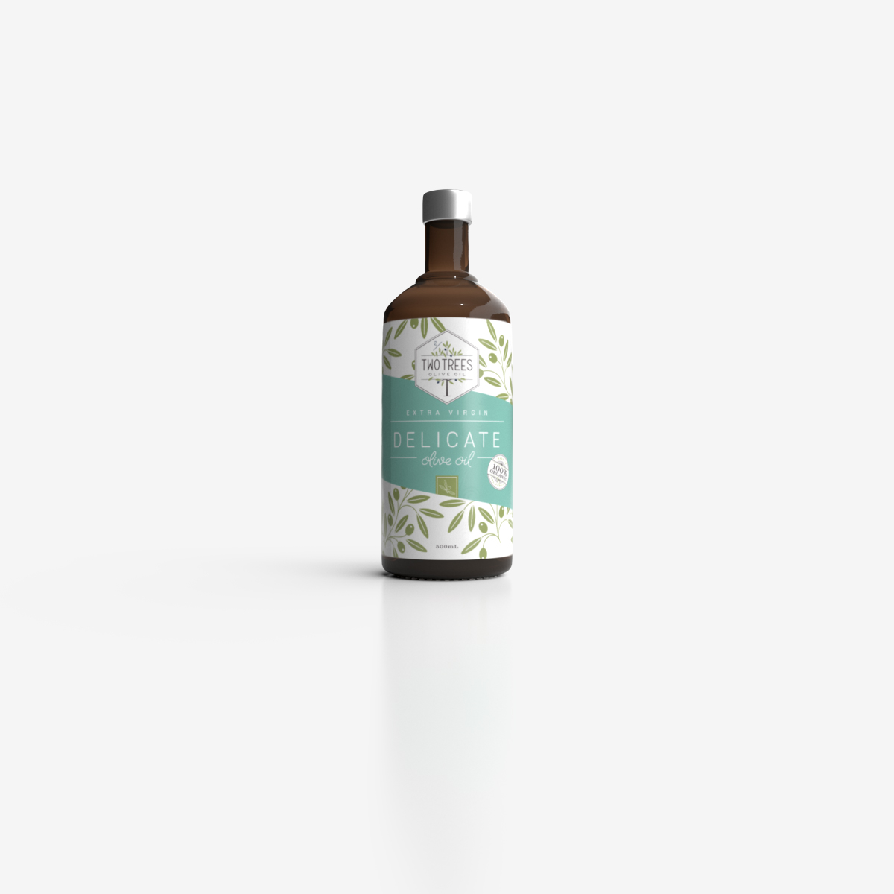
CONCEPT 23 · HOW IT WORKS
Baseline and Version Comparison
1
How it works
Controlled before/after comparison reveals whether a change improved the intended criterion.
2
Best used for
Iterative enhancement and approval evidence.
3
Professional decision
Choose this method when its content model and edge behaviour fit the brief.
4
Quality signal
The reviewer can identify the change and explain its measured or observed effect.
Canva Design Masterclass · C156
Legacy v6 deck · current Canva workflow principles
76

Slide 77
KEY CONTROLS · FAILURE MODE · PROOF
Baseline and Version Comparison · control and judgement
CONTROL MAP
WATCH FOR
QUALITY PROOF
Version name; changed variable; same viewing condition; outcome note.
Overwriting the baseline or changing many factors simultaneously.
The reviewer can identify the change and explain its measured or observed effect.
Decision rule · preserve a baseline, isolate the intended change, then inspect at the delivery size.
Canva Design Masterclass · C156
Legacy v6 deck · current Canva workflow principles
77

Slide 78
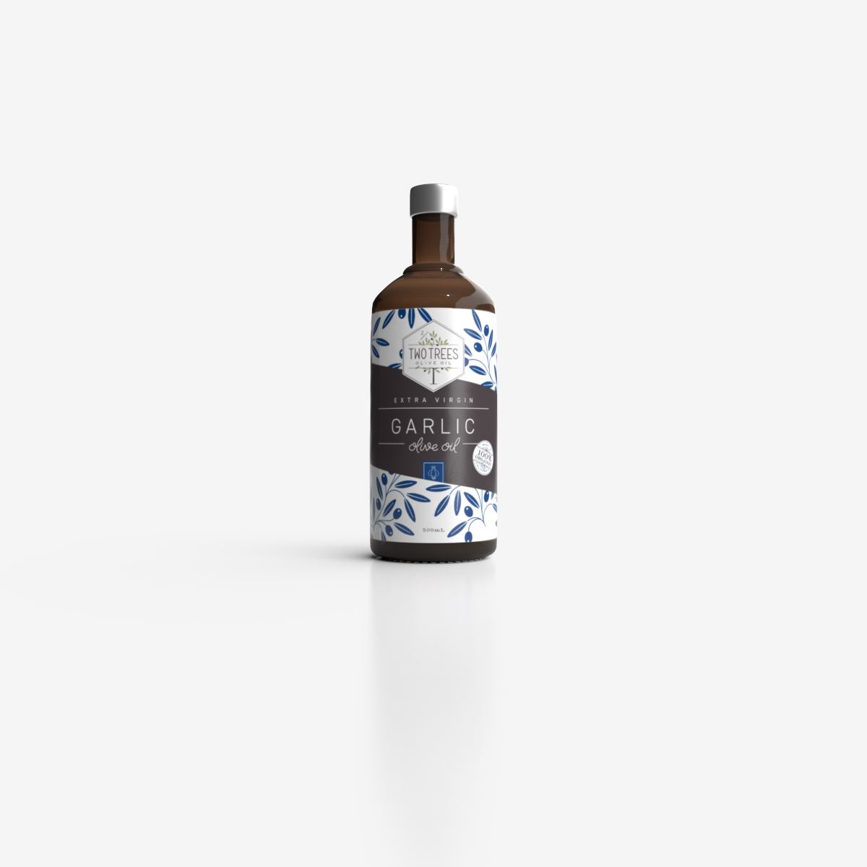
CONCEPT 24 · HOW IT WORKS
Revision Priority
1
How it works
Impact and effort help sequence corrections before refinements.
2
Best used for
Time-boxed projects with multiple review findings.
3
Professional decision
Choose this method when its content model and edge behaviour fit the brief.
4
Quality signal
High-impact issues are resolved before low-risk enhancements.
Canva Design Masterclass · C156
Legacy v6 deck · current Canva workflow principles
78

Slide 79
KEY CONTROLS · FAILURE MODE · PROOF
Revision Priority · control and judgement
CONTROL MAP
WATCH FOR
QUALITY PROOF
Message failure; accessibility; technical defect; brand inconsistency; polish.
Spending time on cosmetic details while critical text remains unreadable.
High-impact issues are resolved before low-risk enhancements.
Decision rule · preserve a baseline, isolate the intended change, then inspect at the delivery size.
Canva Design Masterclass · C156
Legacy v6 deck · current Canva workflow principles
79

Slide 80
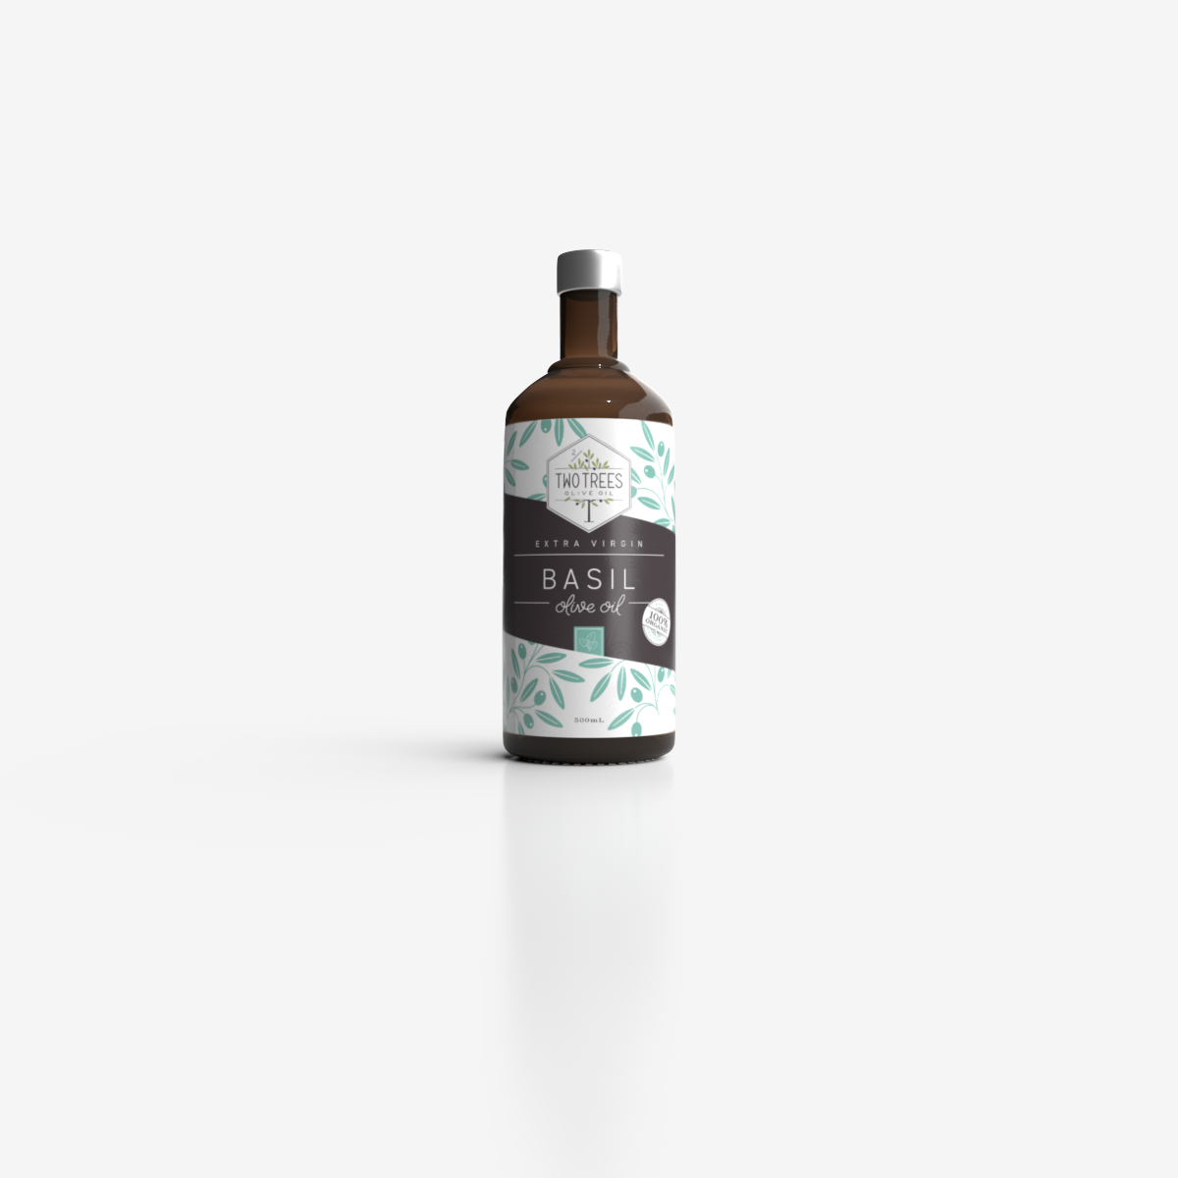
CONCEPT 25 · HOW IT WORKS
Iterative Improvement Loop
1
How it works
Observe, interpret, decide, revise and verify links feedback to evidence.
2
Best used for
Continuous improvement of a design system or campaign.
3
Professional decision
Choose this method when its content model and edge behaviour fit the brief.
4
Quality signal
The final version closes every accepted review action.
Canva Design Masterclass · C156
Legacy v6 deck · current Canva workflow principles
80

Slide 81
KEY CONTROLS · FAILURE MODE · PROOF
Iterative Improvement Loop · control and judgement
CONTROL MAP
WATCH FOR
QUALITY PROOF
Criterion; change; owner; due date; version; verification result.
Making a change without verifying the exported output.
The final version closes every accepted review action.
Decision rule · preserve a baseline, isolate the intended change, then inspect at the delivery size.
Canva Design Masterclass · C156
Legacy v6 deck · current Canva workflow principles
81

Slide 82

HANDS-ON APPLICATION · TOPIC 5
Lab 08 · Peer Review and Iteration
Use structured comments and version comparison to improve a design collaboratively.
1
2
3
4
5
Brief
Compose
Compare
Review
Evidence
EVIDENCE
Baseline, revised version, comment decision log and before/after JPEG.
Review a Lakehouse menu or social tile and close accepted feedback actions.
Full procedure · Learner Guide / Lab 08
Canva Design Masterclass · C156
82

Slide 83
EXPLAIN THE DESIGN DECISION
Topic 5 Checkpoint
Purpose
Method
Control
What must the audience notice or understand?
Why does this visual method fit the brief?
Which setting most changes the result?
Failure
Proof
Next
What defect would make it unacceptable?
Which view, comparison and export demonstrate quality?
What controlled variation would improve it?
Canva Design Masterclass · C156
83

Slide 84
06
Innovative Approaches to Design in Canva
Brand systems · reusable templates · collaboration · multi-format adaptation · responsible AI
LO3
Canva Design Masterclass · C156
84

Slide 85
EDITABLE QUALITY CHART
Visual Review Weighting
READ THE CHART
Aesthetics alone are insufficient: message, readability and channel fitness carry most review weight.
Editable native PowerPoint chart
Canva Design Masterclass · C156
85

Slide 86

CONCEPT 26 · HOW IT WORKS
Brand System
1
How it works
Colour, typography, imagery, layout and voice rules coordinate many outputs.
2
Best used for
Teams producing campaigns at speed without losing recognition.
3
Professional decision
Choose this method when its content model and edge behaviour fit the brief.
4
Quality signal
Different outputs remain recognisably related while fitting their channels.
Canva Design Masterclass · C156
Legacy v6 deck · current Canva workflow principles
86

Slide 87
KEY CONTROLS · FAILURE MODE · PROOF
Brand System · control and judgement
CONTROL MAP
WATCH FOR
QUALITY PROOF
Logo usage; palette; type roles; image treatment; grid; examples.
A brand kit that lists assets but not how to use them.
Different outputs remain recognisably related while fitting their channels.
Decision rule · preserve a baseline, isolate the intended change, then inspect at the delivery size.
Canva Design Masterclass · C156
Legacy v6 deck · current Canva workflow principles
87

Slide 88
CONCEPT 27 · HOW IT WORKS
Multi-Format Adaptation
1
How it works
Each format needs a recomposed hierarchy for its dimensions, context and interaction.
2
Best used for
Social posts, stories, presentations, posters and banners.
3
Professional decision
Choose this method when its content model and edge behaviour fit the brief.
4
Quality signal
Every format preserves the primary message and passes its own visual check.
Canva Design Masterclass · C156
Legacy v6 deck · current Canva workflow principles
88

Slide 89
KEY CONTROLS · FAILURE MODE · PROOF
Multi-Format Adaptation · control and judgement
CONTROL MAP
WATCH FOR
QUALITY PROOF
Aspect ratio; safe area; focal crop; copy length; call-to-action; export.
One-click resizing without checking hierarchy or cropping.
Every format preserves the primary message and passes its own visual check.
Decision rule · preserve a baseline, isolate the intended change, then inspect at the delivery size.
Canva Design Masterclass · C156
Legacy v6 deck · current Canva workflow principles
89

Slide 90

CONCEPT 28 · HOW IT WORKS
Reusable Template Governance
1
How it works
Templates protect repeated structure while defining safe areas for change.
2
Best used for
Distributed teams and recurring communication.
3
Professional decision
Choose this method when its content model and edge behaviour fit the brief.
4
Quality signal
A new contributor can create an approved variant without redesigning the system.
Canva Design Masterclass · C156
Legacy v6 deck · current Canva workflow principles
90

Slide 91
KEY CONTROLS · FAILURE MODE · PROOF
Reusable Template Governance · control and judgement
CONTROL MAP
WATCH FOR
QUALITY PROOF
Locked elements; editable zones; page naming; examples; owner; version.
Templates so rigid they cannot fit real content or so open they lose consistency.
A new contributor can create an approved variant without redesigning the system.
Decision rule · preserve a baseline, isolate the intended change, then inspect at the delivery size.
Canva Design Masterclass · C156
Legacy v6 deck · current Canva workflow principles
91

Slide 92

CONCEPT 29 · HOW IT WORKS
Collaborative Workflow
1
How it works
Roles, comments, approvals and version conventions coordinate distributed design work.
2
Best used for
Team ideation, review and handoff in Canva.
3
Professional decision
Choose this method when its content model and edge behaviour fit the brief.
4
Quality signal
The design history shows who requested, changed and approved each revision.
Canva Design Masterclass · C156
Legacy v6 deck · current Canva workflow principles
92

Slide 93
KEY CONTROLS · FAILURE MODE · PROOF
Collaborative Workflow · control and judgement
CONTROL MAP
WATCH FOR
QUALITY PROOF
Owner; editor; commenter; due date; status; approval; naming.
Unresolved comments, duplicate versions and unclear final authority.
The design history shows who requested, changed and approved each revision.
Decision rule · preserve a baseline, isolate the intended change, then inspect at the delivery size.
Canva Design Masterclass · C156
Legacy v6 deck · current Canva workflow principles
93

Slide 94
CONCEPT 30 · HOW IT WORKS
Responsible AI-Assisted Visuals
1
How it works
AI can accelerate ideation and production, but humans retain responsibility for the published result.
2
Best used for
Concept exploration, draft copy, image generation and controlled variations.
3
Professional decision
Choose this method when its content model and edge behaviour fit the brief.
4
Quality signal
The selected output has a documented prompt, human review and usage decision.
Canva Design Masterclass · C156
Legacy v6 deck · current Canva workflow principles
94

Slide 95
KEY CONTROLS · FAILURE MODE · PROOF
Responsible AI-Assisted Visuals · control and judgement
CONTROL MAP
WATCH FOR
QUALITY PROOF
Prompt; source rights; factual check; artefact review; bias; provenance; approval.
Publishing plausible-looking outputs without checking accuracy or permissions.
The selected output has a documented prompt, human review and usage decision.
Decision rule · preserve a baseline, isolate the intended change, then inspect at the delivery size.
Canva Design Masterclass · C156
Legacy v6 deck · current Canva workflow principles
95

Slide 96
HANDS-ON APPLICATION · TOPIC 6
Lab 09 · Multi-Format Campaign Adaptation
Recompose one message across formats while preserving brand recognition and hierarchy.
1
2
3
4
5
Brief
Compose
Compare
Review
Evidence
EVIDENCE
Three format JPEGs plus a comparison board.
Adapt a Lakehouse campaign into square post, vertical story and presentation slide formats.
Full procedure · Learner Guide / Lab 09
Canva Design Masterclass · C156
96

Slide 97
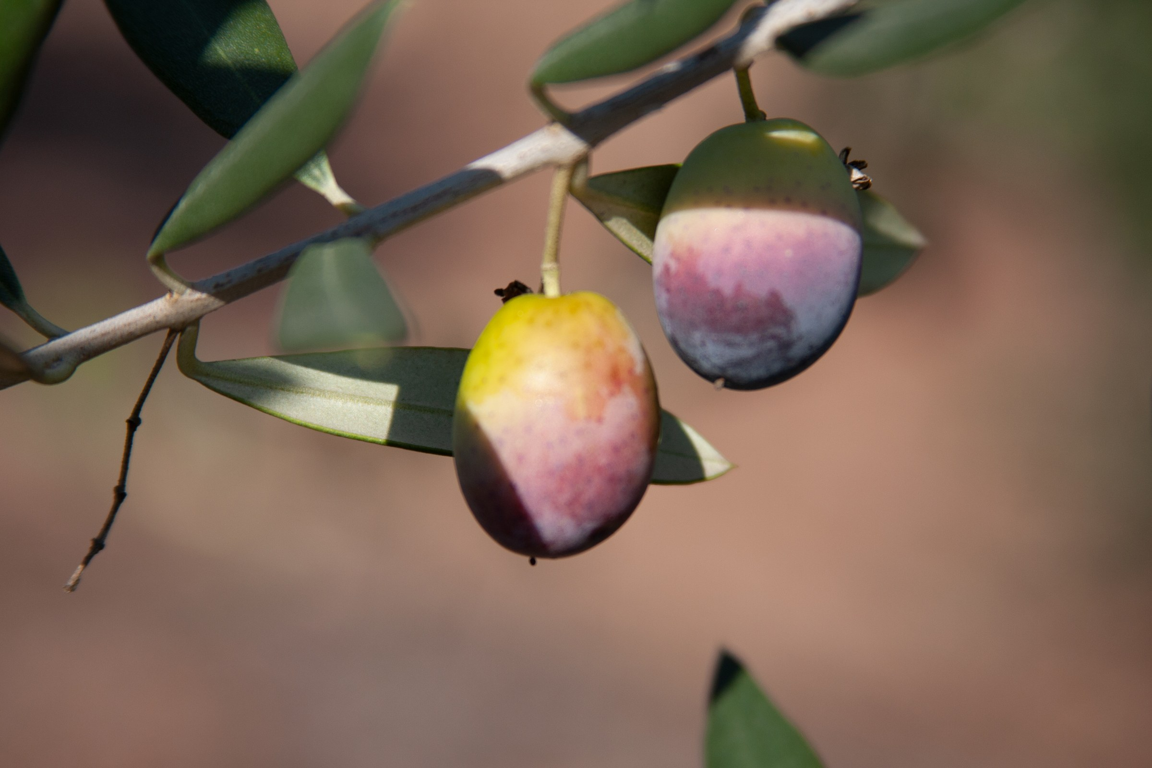
HANDS-ON APPLICATION · TOPIC 6
Lab 10 · Collaborative Brand Campaign Capstone
Integrate brief, mood board, advertisement, storyboard, critique and enhancement strategy into one coherent campaign.
1
2
3
4
5
Brief
Compose
Compare
Review
Evidence
EVIDENCE
Campaign brief, mood board, brand rules, two campaign visuals, storyboard, critique record, revised output, enhancement strategy and final JPEG package.
Produce a launch mini-campaign for the Two Trees olive-oil range and prepare it for team handoff.
Full procedure · Learner Guide / Lab 10
Canva Design Masterclass · C156
97

Slide 98
EXPLAIN THE DESIGN DECISION
Topic 6 Checkpoint
Purpose
Method
Control
What must the audience notice or understand?
Why does this visual method fit the brief?
Which setting most changes the result?
Failure
Proof
Next
What defect would make it unacceptable?
Which view, comparison and export demonstrate quality?
What controlled variation would improve it?
Canva Design Masterclass · C156
98

Slide 99
COURSE SYNTHESIS
Professional Visual-Communication Workflow
Brief
Source
Construct
Clarify purpose, audience, channel and constraints.
Choose suitable, rights-cleared assets.
Use visible hierarchy and a repeatable layout system.
Experiment
Evaluate
Deliver
Vary one factor against a baseline.
Inspect visual, technical and rights criteria.
Export, reopen and retain the named baseline and final version.
Canva Design Masterclass · C156
99

Slide 100
RESPONSIBLE ASSET USE
Copyright and Asset Permission
Ownership
Permission
Scope
Identify the creator or owner.
Public visibility does not grant reuse.
Check modification, commercial and redistribution rights.
People
Attribution
Record
Confirm consent and privacy context.
Credit as the licence requires.
Retain source, licence, consent, date and use.
Canva Design Masterclass · C156
IPOS Copyright Resources
100

Slide 101
CRITIQUE AND ENHANCE
Peer Review
Describe
Show
Ask
State purpose and key decisions.
Reveal baselines, alternatives and comments.
Use explicit evaluation criteria.
Record
Decide
Revise
Capture what the reviewer noticed.
Accept, adapt or reject with a reason.
Make one traceable improvement.
Canva Design Masterclass · C156
101

Slide 102
HELP IMPROVE DELIVERY
Course Feedback
Complete
Be specific
Rate fairly
Use the course feedback form shared by your trainer.
Name the explanation or resource that helped or blocked you.
Separate content, facilitation, venue and administration.
Suggest
Support
Contact
Describe one practical improvement.
Post-course subject consultation is available.
enquiry@tertiaryinfotech.com · +65 6100 0613
Canva Design Masterclass · C156
102

Slide 103
CONTINUE THE CREATIVE WORKFLOW
Recommended Courses
Photoshop
InDesign
After Effects
Edit and composite raster imagery.
Build print and digital publications.
Animate graphic systems.
Premiere Pro
UI Design
Portfolio
Edit campaign video.
Apply hierarchy to digital interfaces.
Document process and verified outputs.
Canva Design Masterclass · C156
103

Slide 104
AFTER THE COURSE
Support
Email
Telephone
Portal
enquiry@tertiaryinfotech.com
+65 6100 0613
https://lms-tms.tertiaryinfotech.com/
Provider
Website
Privacy
Tertiary Infotech Academy Pte Ltd
www.tertiarycourses.com.sg
Do not share other learners' work publicly.
Canva Design Masterclass · C156
104

Slide 105
Thank You
Communicate clearly · critique constructively · improve visibly
C156 · Canva Design Masterclass
Canva Design Masterclass · C156
105

